Slide 1
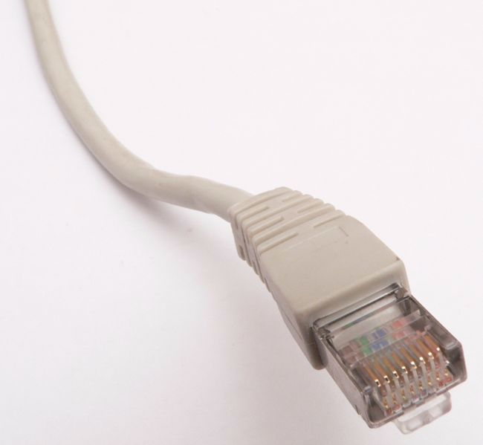
LAN Technologies
Ethernet

Slide 2
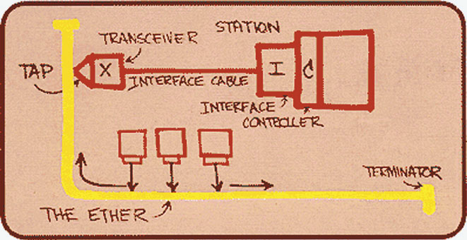
Original Ethernet

Slide 3
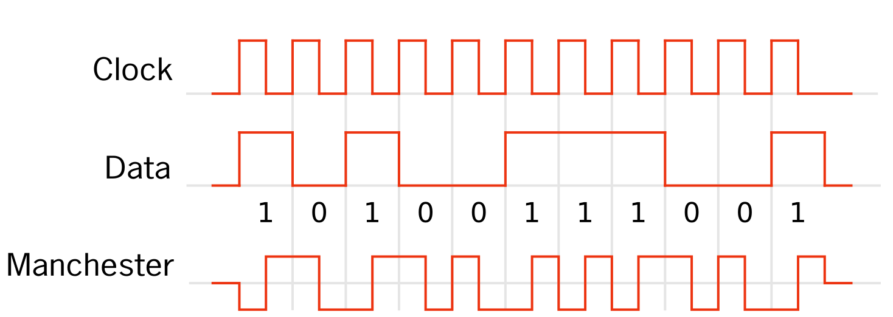
Manchester Code

Slide 4
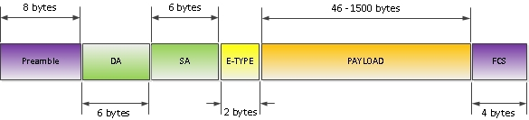
Ethernet Frame Format

Slide 5
Minimum Frame Size
If the frame is short and the distance between computers is large, the sender may not detect collisions
If the sender finishes sending the frame before the collision signal arrives, it will think that the collision signal does not apply to it
Corrupted packets should not be processed by network or transport layer, because it is too slow

Slide 6
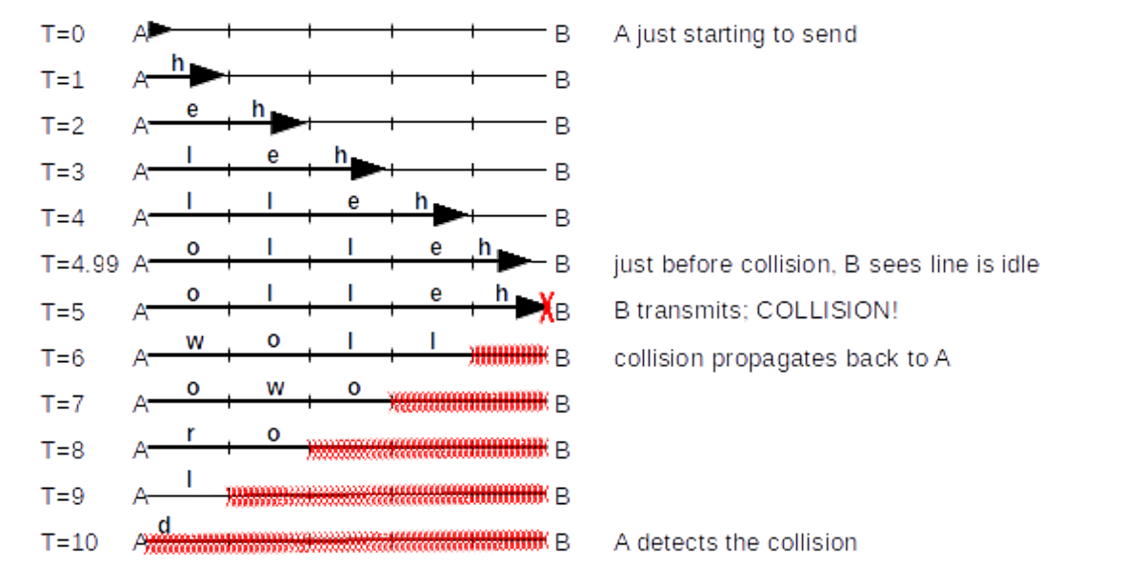
Minimum Frame Size
2T – minimum signal transmission time
T=L/c, where c is the speed of light

Slide 7
Minimum Frame Size and Maximum Channel Length
Let
  M - minimum frame size
  P – bandwidth
  M/P – time to write the frame into the channel
Relationship between bandwidth, channel length, and minimum frame size:
  M/P > 2T, where T=L/c
Examples:
  P=10 Mb/s M=64 B then L < 7680 m
  P=10 Gb/s M=64 B then L < 7,68 m

Slide 8
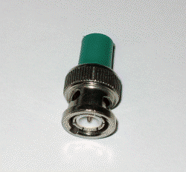
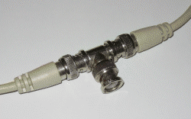
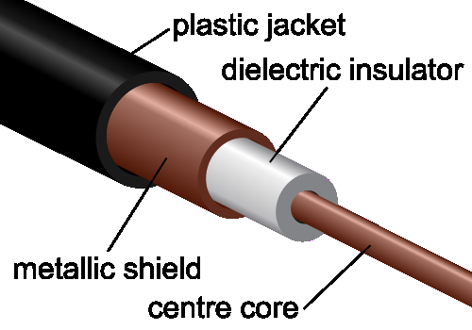
Ethernet 10BASE2 (IEEE 802.3 a) Coaxial Cable
Uses CSMA / CD
Now deprecated
10 Mbps data transfer rate
Maximum channel length: 200 and 500m
host
host
host
host

Slide 9
Fast Ethernet (100 Mbps)
Twisted pair
Abandoning the bus topology – local network nodes form a "star" with a hub or switch in the center
The transmission is in duplex mode
In case of connection via a hub, the following applies: CSMA/CD
Fast Ethernet standards differ by the transmission medium and other characteristics:
  100BASE-T - twisted pair
  100BASE-FX, 100BASE-LX - optical fiber

Slide 10
Fast Ethernet Standards
100BASE-T4: UTP category 3
(max 25 MHz); all 4 pairs are used (3→ 1←); ternary signals; half-duplex
100BASE-TX: UTP category 5 (max 125 MHz);
2 pairs are used (1→ 1←); duplex
100BASE-FX: multimode fiber (1→ 1←); maximum length of 2 km
100BASE-LX: single-mode fiber (1→ 1←); maximum length of 15 km

Slide 11
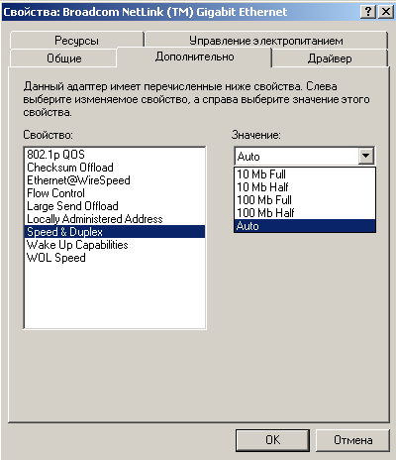
Ethernet Settings

Slide 12
1 and 10 Gbps Ethernet
1000BASE-T: twisted pair of category 5, 5e or higher; half-duplex; all 4 pairs participate in the transmission (125 MHz and 5 voltage levels, for a total of 125*4 pairs*2 bits=1000)
1000BASE-SX and LX: multimode and singlemode fiber; distance up to 500m and 20km;
10GBASE-T: category 6a twisted pair (16 voltage levels 650MHz*4 pairs*4bits)

Slide 13
Twisted pair
"Twisted" - to reduce the influence of external interference
The cable usually consists of four pairs
Types of cable:
  UTP — Unshielded twisted pair
  FTP — Foiled twisted pair
  STP — Shielded twisted pair
Cable Categories: CAT 1 – 7

Slide 14
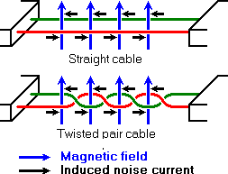
Twisted pair

Slide 15
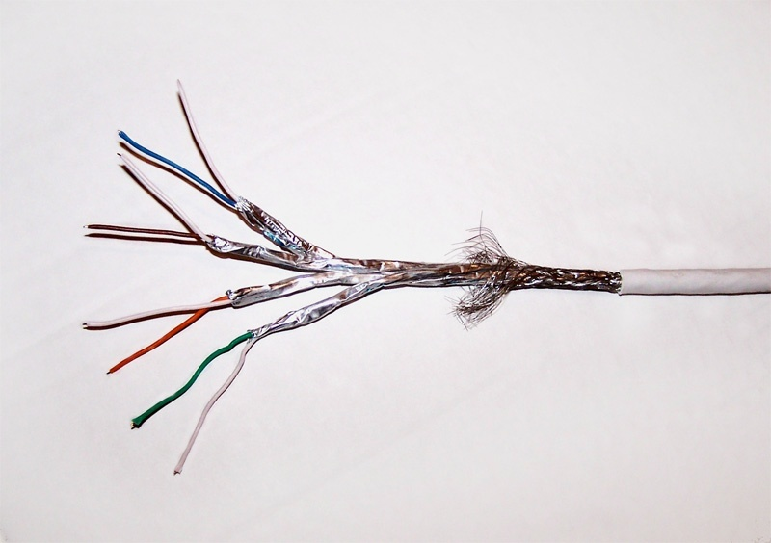
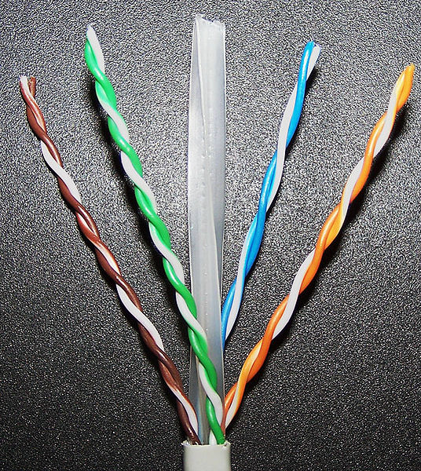
Twisted pair
of categories 7 and 6

Slide 16
Power over Ethernet
Transmitting power along with the signal
Both free pairs and phantom power via signal wires can be used
The voltage is adjusted automatically
Passive PoE: self-made power supply for free pairs in 100BASE-TX without automatic voltage adjustment

Slide 17
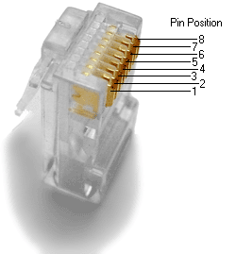
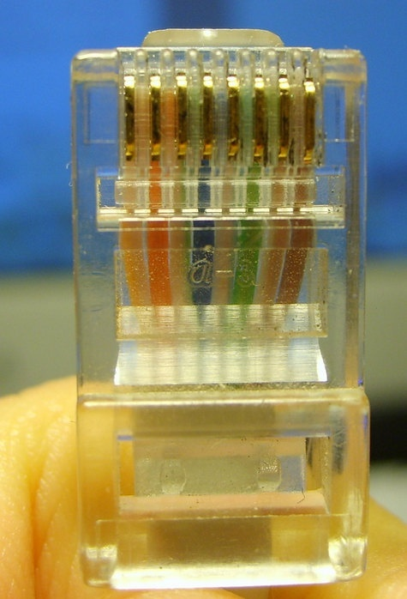
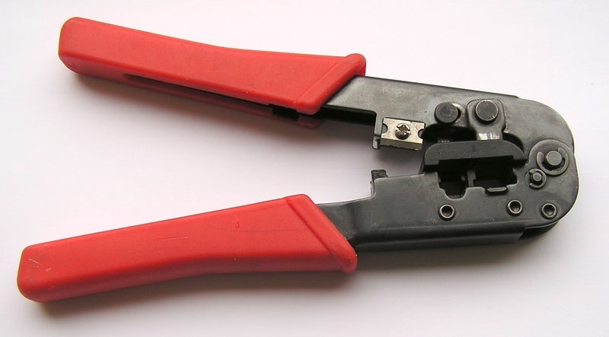
Connectors and Cable Crimping Device

Slide 18
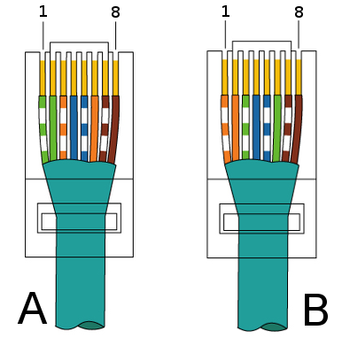
Crimping Schemes

Slide 19

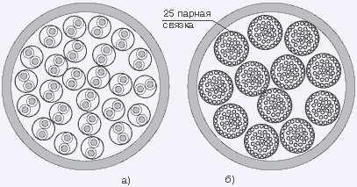
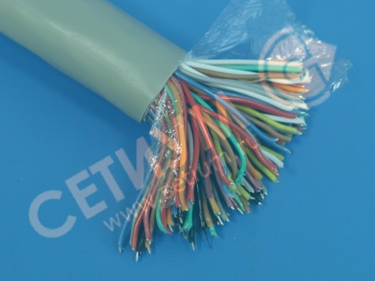
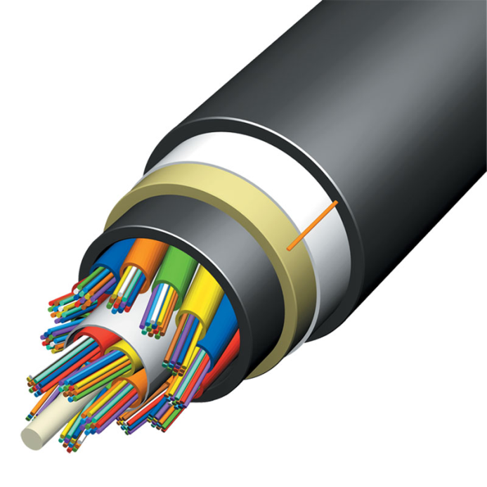
Trunk cable
(twisted pair and fiber)

Slide 20
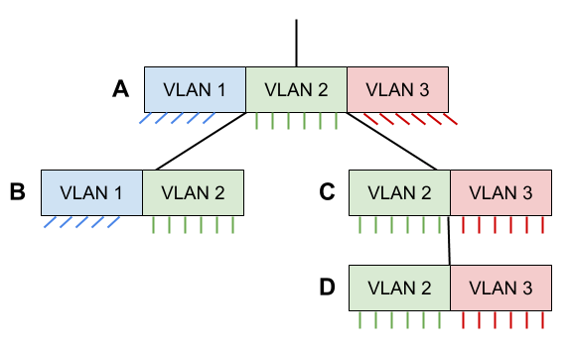
VLAN in an Ethernet Switch Network
On trunk channels, the VLAN tag is added to the Ethernet frames after the "Type" field

Slide 21
Optical Fiber
Light signals can be transmitted through glass or plastic threads
Light does not escape from the fiber due to the effect of full internal reflection
Advantages:
  Huge throughput
  Immunity to electromagnetic interference
  The upgrade is performed by replacing the receivers/ transmitters, not the entire cable

Slide 22
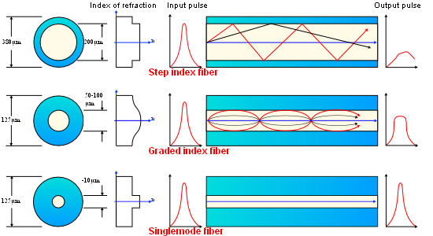
Types of Optical Fiber
Singlemode – the signal propagates in a single straight line along the fiber
Multimode – the signal propagates in zigzags/sinusoids with different steps

Slide 23
Types of Optical Fiber
Single-mode fiber is cheaper and provides transmition over long distances (100 km) without repeaters
But the equipment (receivers and laser transmitters) is much more expensive
Cheap LED sources are used for multimode fiber
The lower maximum length of the multimode cable (500m) is due to optical fiber dispersion

Slide 24
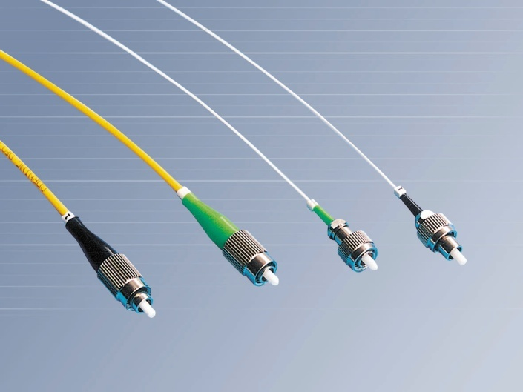
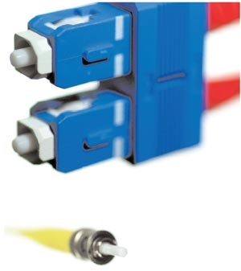
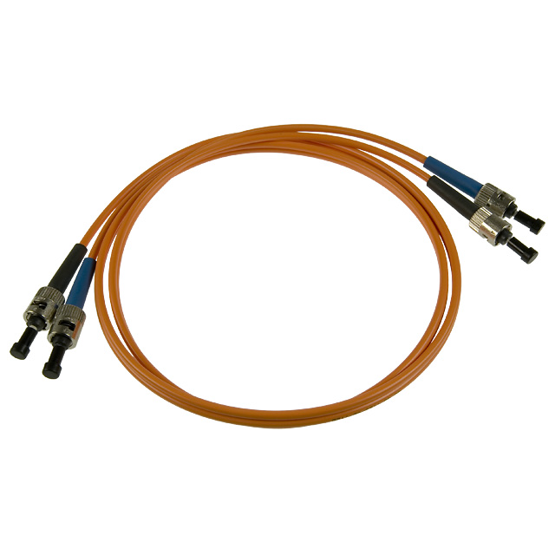
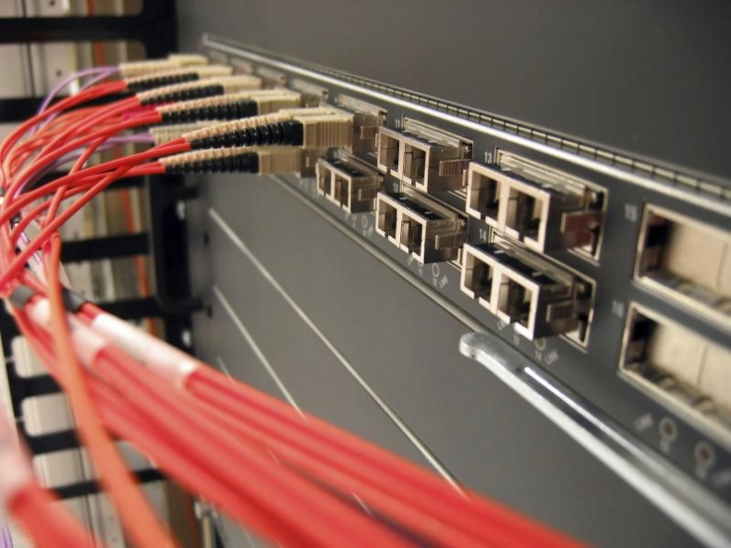
Optical Fiber

Slide 25
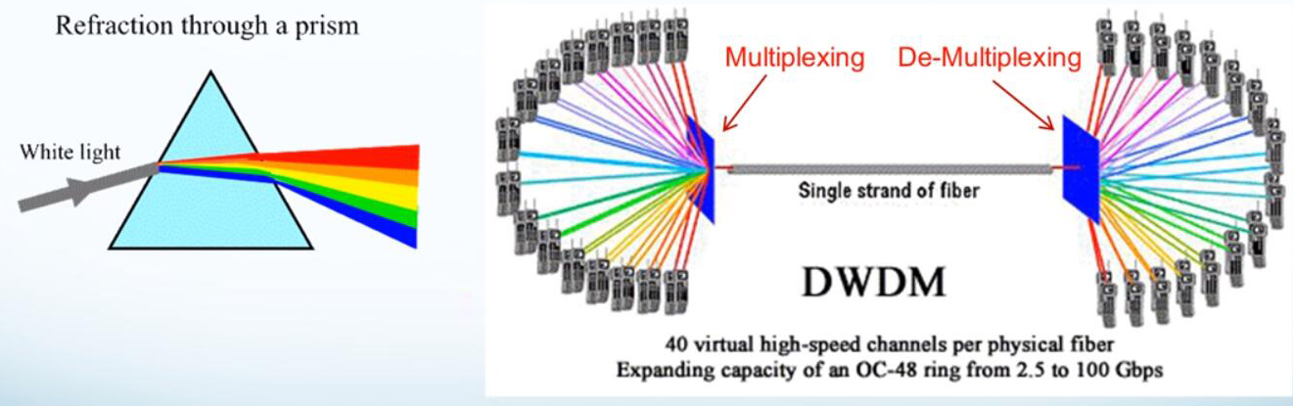
Wavelength-Division Multiplexing
Technology that provides simultaneous transmission of several data streams over a single optical fiber at different carrier frequencies

Slide 26
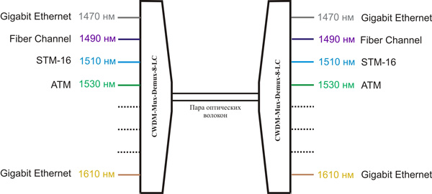
Wavelength-Division Multiplexing
Supports various bitrates and protocols
Significantly increases bandwidth of existed channels

Slide 27
WDM Types
Coarse WDM (CWDM)
Dense WDM (DWDM)
Specifications | CWDM | DWDM
Number of channels | 8 – 16 | 40 – 80
Gap between channels | 2500GHz (20nm) | 100 GHz (0.8nm)
Throughput capacity | 20 – 40 Gbps | 100 – 1000 Gbps

Slide 28
Repeaters and hubs (now obsolete)
Work on physical address layer
Repeaters are used to amplify the signal
Hubs are designed to combine multiple Ethernet devices into a single network segment
Repeat incoming frame
to all active ports
host
host
host
host
Hub

Slide 29
Switches
They work on Data link layer!
Unlike a hub, a switch only transmits data directly to the recipient
If the network is busy, the frame is not lost, but waits in the switch buffer. This way, no collisions occur.
The switch can be managed by web interface

Slide 30
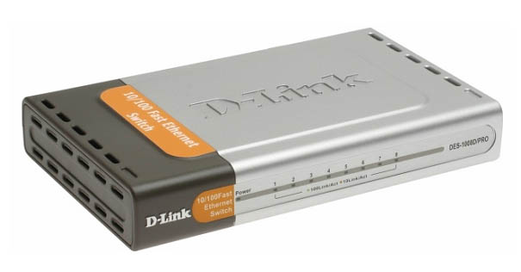
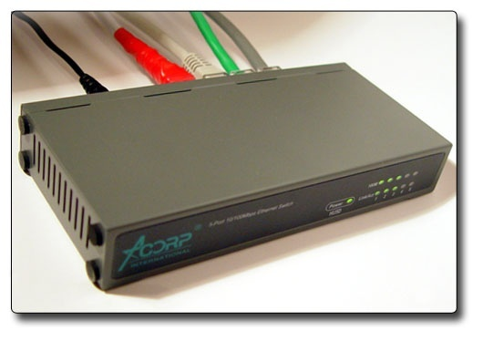
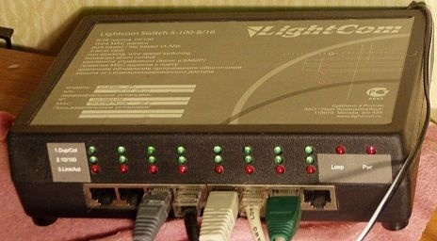
Switches

Slide 31

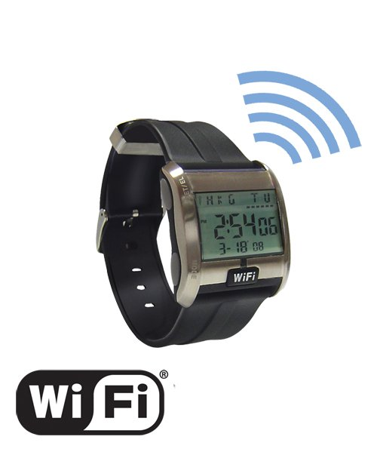
LAN Technologies
IEEE 802.11

Slide 32
WiFi. General principles
Data is transmitted over a radio channel
Speed 54 Mbps/c (for IEEE 802.11g)
Two operating modes:
  with an access point (infrastructure mode)
  without an access point (ad-hoc)
Media Access Protocol: CSMA/CA

Slide 33
Infrastructure mode
The access point acts as a bridge between the wireless and wired networks
Every 0.1 s with a signal packet, it transmits its network identifier (SSID)
If two access points with identical SSIDs are in range, the program can choose between them based on signal strength data

Slide 34
WiFi Standards
IEEE 802.11 - initial 1 Mbit/s and 2 Mbit/s (1997)
IEEE 802.11a 54 Mbit/s DSSS
IEEE 802.11b 11 Mbit/s OFDM
IEEE 802.11g 54 Mbit/s
IEEE 802.11n 600 Mbit/s

Slide 35
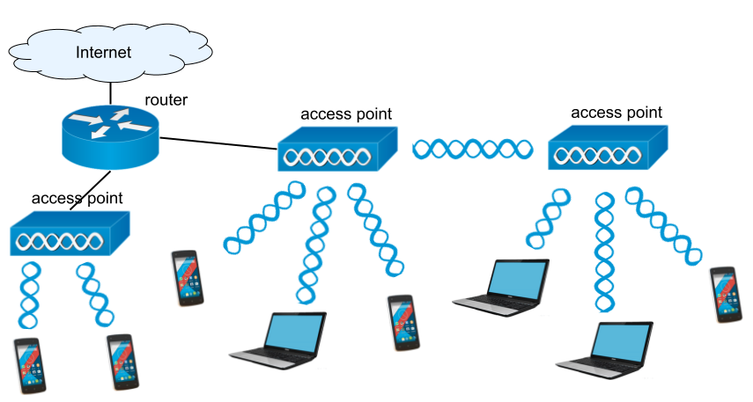
Extended Service Set (ESS) Scheme
Notes:
ESS - Extended Service Set
BSS - Basic Service Set

Slide 36
Data Encryption
Wired Equivalent Privacy (WEP) - first standard (key: 5 or 13 ASCII-characters) – is not strong enough for cryptography
Wi-Fi Protected Access (WPA) - includes 802.1x, TKIP protocols, MIC and the encryption standard AES (Advanced Encryption Standard - in WPA2)
  802.1x - user authentication protocol (requires a special RADIUS server)
  TKIP (Temporary Key Integrity Protocol) - dynamic encryption keys (change very frequently)
  MIC - Message Integrity Check (to prevent changes of data by hackers)

Slide 37
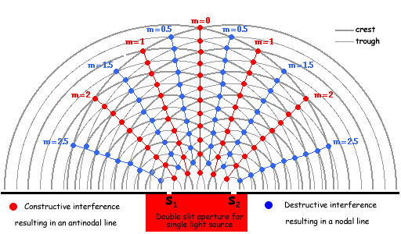

MIMO

Slide 38
MIMO – Multiple Input Multiple Output
Precoding - multi-stream beamforming. The same signal is emitted from each of the transmit antennas with appropriate phase and gain weighting such that the signal power is maximized at the receiver input
Spatial multiplexing - a high-rate signal is split into multiple lower-rate streams and each stream is transmitted from a different transmit antenna in the same frequency channel
Diversity coding - a single stream is transmitted, but the signal is coded using techniques called space-time coding. The signal is emitted from each of the transmit antennas with full or near orthogonal coding

Slide 39
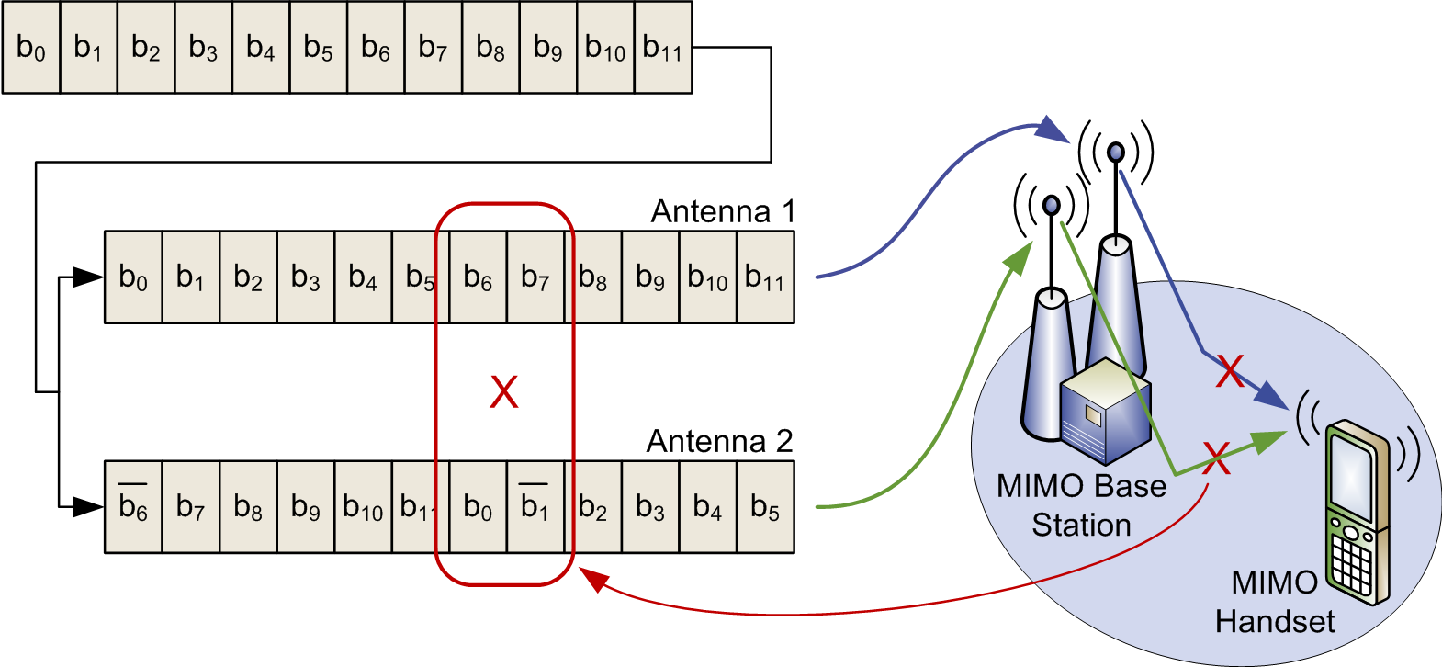
MIMO (Diversity coding)

Slide 40
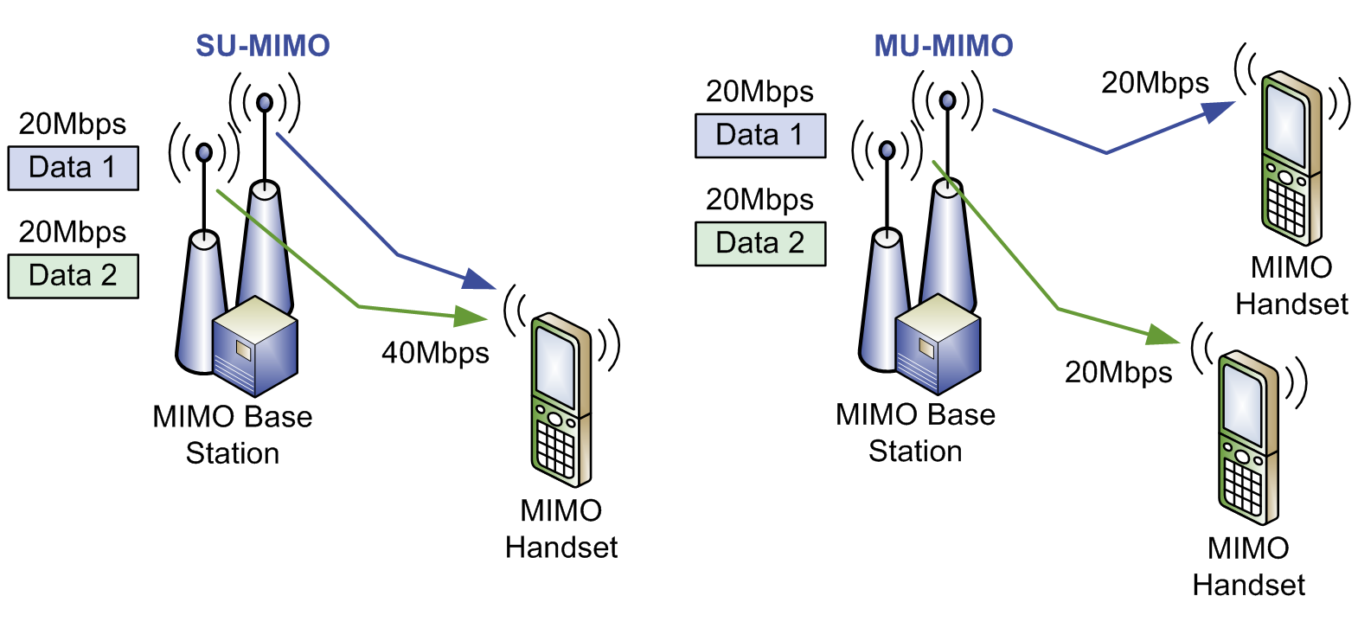
MIMO

Slide 41
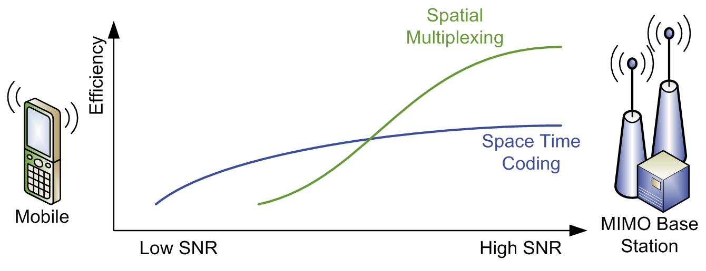
AMS – Adaptive MIMO Switch

Slide 42
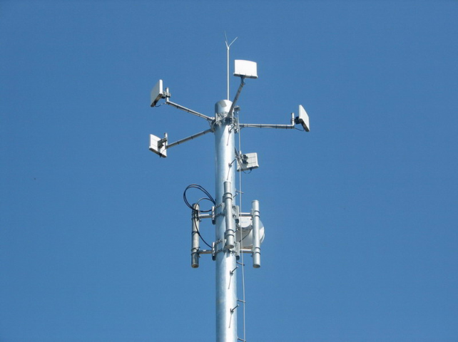
WiMAX
Worldwide Interoperability for Microwave Access – standard IEEE 802.16 wireless connection far away activities (10 km)
Problem CSMA/CA – more remote subscribers are less likely to transmit the packet to the access point
Output – use TDMA
For user groups
possible use of
FDMA

Slide 43
WiMAX. Kinds
802.16d - fixed WiMAX
  fixed modems, PCMCIA cards for laptops
802.16e - mobile WiMAX (4G)
  roaming is provided
Speed – up to 1 Gbit / s

Slide 44

Mobile network technologies

Slide 45
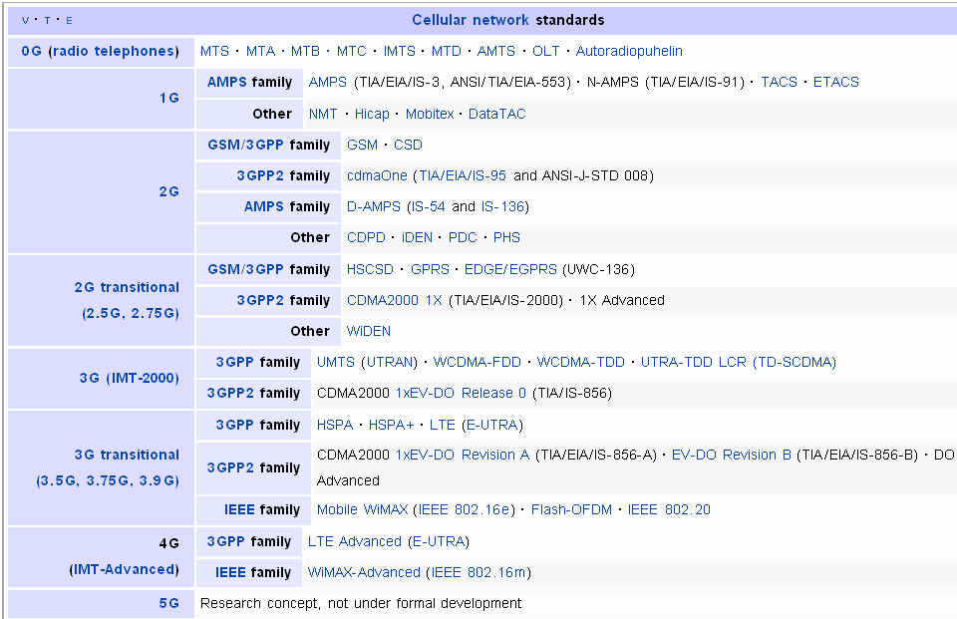
Variety of standards

Slide 46
Wireless technologies
QoS
Range
CDMA
OFDM
OFDM/MIMO
Mobility
Access
Long range version of WiFi
High data rate version of 3G
WiMAX
LTE
GPRS
UMTS
HSDPA
Scheduling
Guaranty BW
High
5 Km
384K
2M
14M
75M
100 m
54MHz
108M
Priority
11M
Limited
Contention
WiFi
802.11b
WiFi
802.11n
WiFi
802.11a/g
10M bps
50M bps
Data Rate
Freq:1.9GHz, 2.1GHz
BW: 2 X 5MHz
Freq:2.4GHz, 5GHz
BW:20MHz
Freq: 2.3GHz, 2.5GHz, 3.5GHz, 5GHz
BW: 1.25,2.5, 3.5, 5, 7, 10, 14, 20MHz

Slide 47
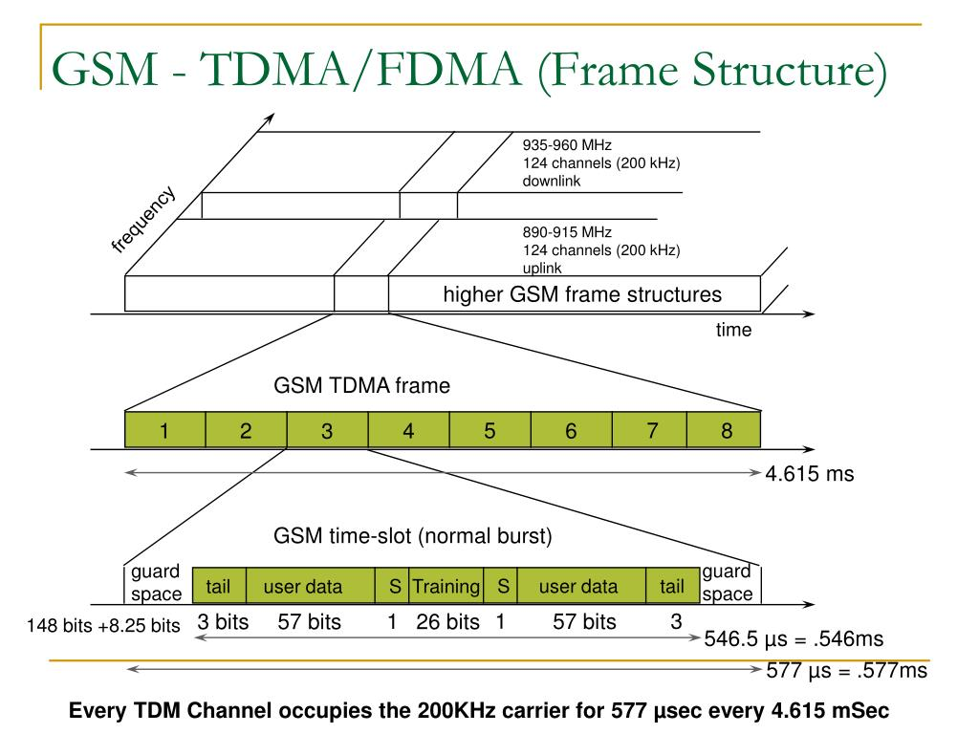
GSM - Global System for Mobile Communication
Standards:
1982 CEPT,
1989 ETSI
(8000 page)
TDMA and
FDMA

Slide 48
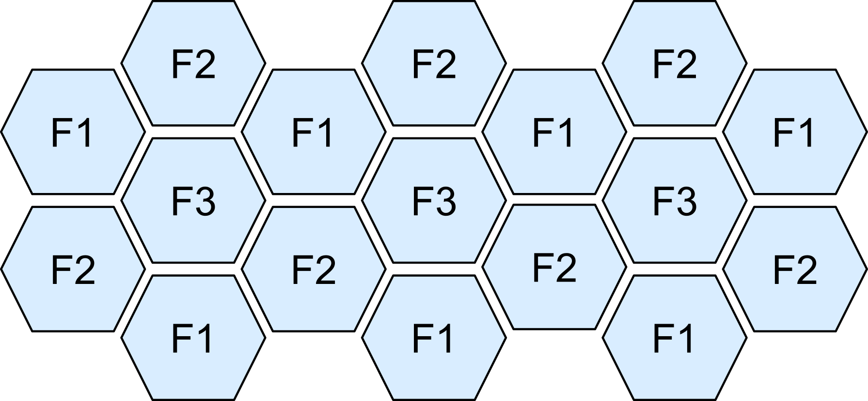
Honeycombs
Cells with one frequency are interspersed with cells with other frequency
Cellular network ideas: the level of mutual interference does not depend on the actual distance between cells, but on the ratio of the distance between cells to their radius

Slide 49
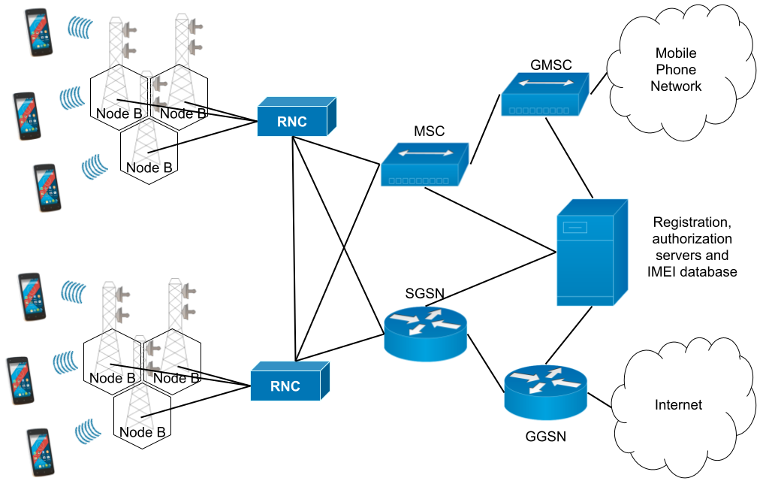
3G network diagram

Slide 50
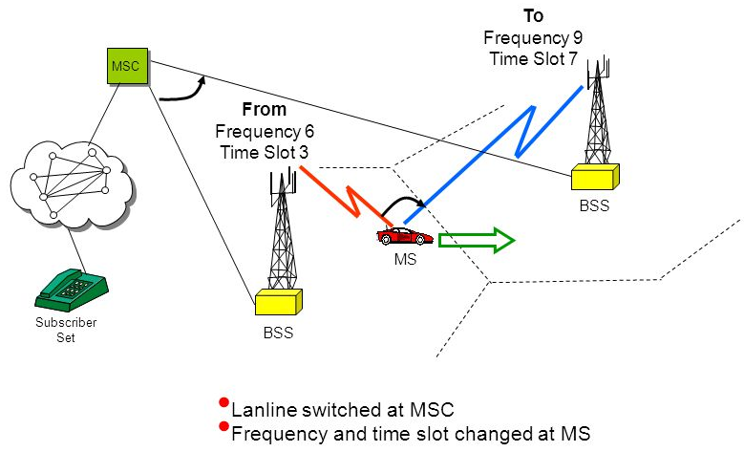
Handover

Slide 51
GPRS - General Packet Radio Service
Packet Radio Service add-on to GSM that performs packet data transmission
  Multiple access: each user is allocated a pair of frequencies, and the time slots of these frequencies are allocated using Reservation-ALOHA
Error-correcting convolutional encoding is applied (types: CS1-CS4 (9-21 kbit / s))

Slide 52
EDGE
Enhanced Data rates for GSM Evolution
Usage a different type of signal modulation (8 Phase Shift Keying) results in 3 times increasing the data transfer rate
8 encoding types MCS1-8 from 8.4 kbit/s to 59.2 kbit/s
x 8 time slots = up to 474 kbps

Slide 53
CDMA - a Rival of GSM
Standards:
  cdmaOne (IS-95), 90e years, 10-100 kbit / s
  Wideband CDMA – up to 384 kbps
  CDMA2000 - up to 2.4 Mbit / s in the forward channel and up to 153 kbit/s in the reverse channel;
  uses orthogonal Walsh-Hadamard codes for multiple access;
  errors are corrected by turbo coding

Slide 54
UMTS, HSPA
UMTS - Universal Mobile Telecommunications System – implementing of WCDMA inside GSM-networks
HSPA - High Speed Packet Access – improved WCDMA (5.8, 14 Mbit/s)
  multicode transmission;
  improved encoding schemes
HSPA+ (22, 84 Mbit / s) - usage MIMO and another signal modulation

Slide 55
LTE Advanced
(Long Term Evolution)
MIMO (3.3 Gbit / s for 8x8)
As opposed to WCDMA it can operate on a frequency band of various widths (1.4-100MHz).
all-IP - infrastructure, small ping
FDD (frequency division duplexing) and TDD (time division duplexing)
Support MBSFN (Multicast Broadcast Single Frequency Network) – for TV broadcasting
Automatic offline hardware configuration

Slide 56
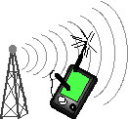
TCP over Unreliable Connections

Slide 57
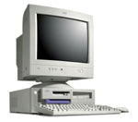
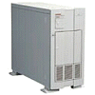
Packet Distortion in Wireless Networks
Router
Host 1
Host 2
Loss → Traffic jam
3
2
2
2
1
2
0
Loss → Traffic jam
Packet loss leads to long delays
and unjustified reduction of the data transfer rate by the TCP driver
Host 3

Slide 58
Problems
Due to interference, signal attenuation, packets are often lost or distorted in wireless networks
TCP does not distinguish packet loss due to congestion from dropped packets due to distortion
TCP unnecessarily reduces the window size, assuming that the channel is narrow
This leads to inefficient use of the channel

Slide 59
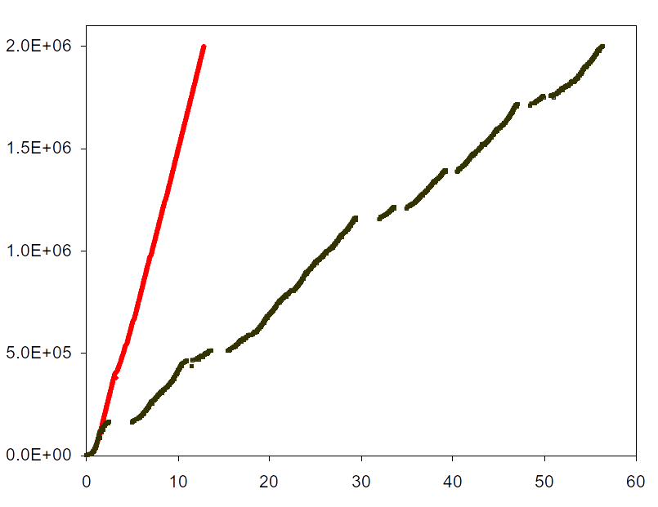
Reduced Efficiency
TCP no errors
(1.30 Mbps)
The real one
(280 Kbps)
Byte number
Time (with)
Broadcast 2MB by TCP over 2 Mbps wireless connection

Slide 60
Possible Solutions
Changing the implementation TCP
  Selected ACK (do not use group ACK, only selective ACK)
  Include a flag in the receipt indicating that the packet was lost due to poor wireless connection quality
  Problem: this will only work one way
Wired connection
Wireless connection

Slide 61
Possible Solutions
(link layer)
Using local retransmissions
Using noise-tolerant encoding (problem: it doesn't work for large data losses)
Wired connection
Wireless connection

