Slide 1
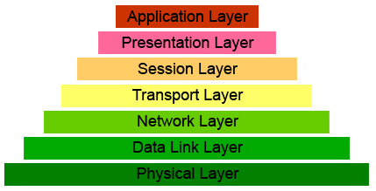
Data Link Layer

Slide 2
Data Link Layer
Channel Types
point-to-point
broadcast (Ethernet, WiFi, Sputnik)
tacking turns
Main tasks:
transfer frames between directly connected computers
management of the access to the communication line (MAC)
flow control
error detection and correction

Slide 3
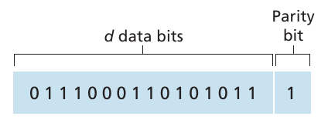
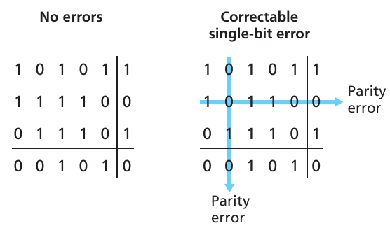
Errors: parity control

Slide 4
Errors: CRC checksum

Slide 5
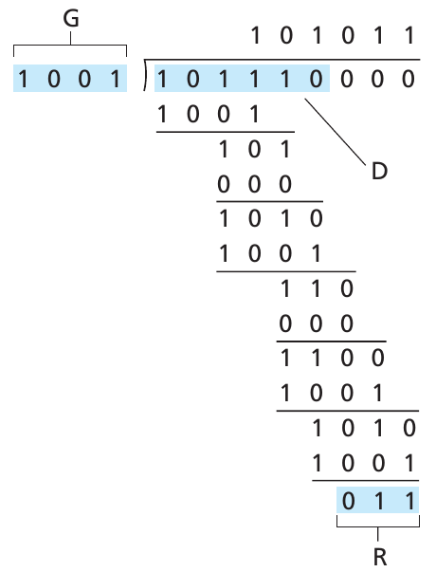
Errors: CRC checksum

Slide 6
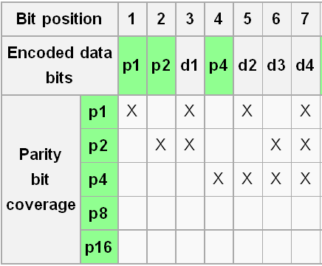
Hamming Codes

Slide 7
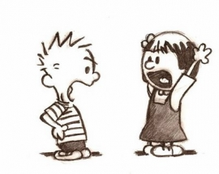
Media Access Control

Slide 8
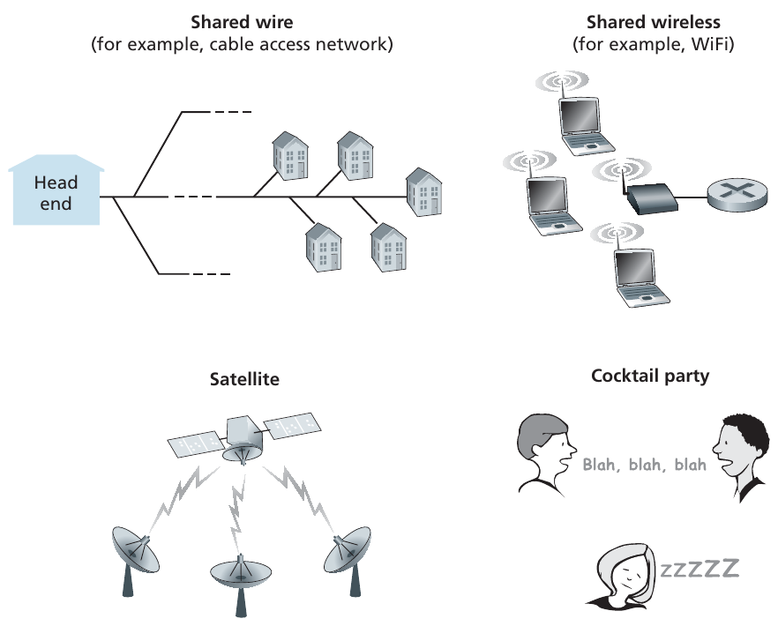

Slide 9
Multiple Access Protocols
A real-life analogy: in the classroom, the teacher and students use the same broadcast channel
Main question: Who should speak now?, i. e., transmit data over the channel
You can come up with several rules for communication:
“Give everyone a chance to speak.”
“Don’t speak until you are spoken to.”
“Don’t monopolize the conversation.”
“Raise your hand if you have a question.”
“Don’t interrupt when someone is speaking.”
“Don’t fall asleep when someone is talking.”

Slide 10
Types of Protocols
Channel Partitioning Protocols
TDMA
FDMA
CDMA
SDMA
Random Access Protocols
ALOHA
CSMA/CD (Ethernet, WiFi)
Taking Turns Protocols
Polling protocol
Token Passing Protocol (Token ring)

Slide 11
Channel Partitioning Protocols
TDM - Time Division Multiplexing

Slide 12
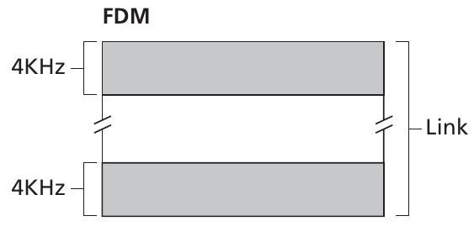
Channel Partitioning Protocols
FDM - Frequent Division Multiplexing

Slide 13
Channel Partitioning Protocols
CDMA - Code Division Multiple Access
Each transmitter is assigned its own code, which it uses to encode data
The signal is received by everyone, and only the one who is intended to decipher it correctly
Noise immunity
CDMA network capacity is usually several times higher FDMA and TDMA-networks

Slide 14
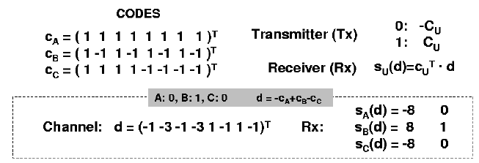
Code Division Multiple Access

Slide 15
SDMA - Space Division Multiple Access
Spatial division of the channel:
Dividing a region into cells
Use of directional antennas that emit a signal over selected sectors

Slide 16
Random Access Protocols. ALOHA
The first protocol of this type
Each node transmits immediately after receiving data from the network layer
If there is a collision, then sends it again
Nodes, like ill-mannered interlocutors, interrupt other speakers and do not stop talking
Should a packet be retransmitted immediately?

Slide 17
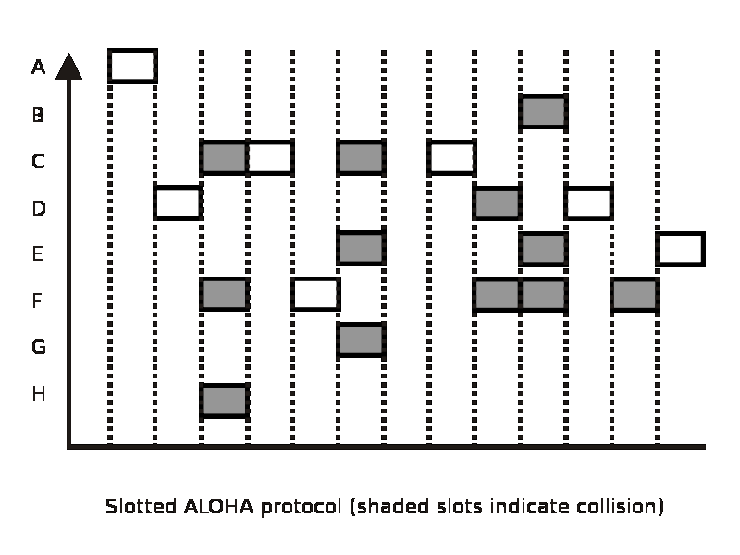
Slotted ALOHA

Slide 18
Comparison
ALOHA
Slotted ALOHA
collision
sender A
sender B
sender C
t
collision
sender A
sender B
sender C
t

Slide 19
Random access protocols. CSMA/CD
Carrier-Sense Multiple Access with Collision Detection
Rules:
Listen before transmit (carrier sense)
If someone also starts transmitting, stop the transmittion (collision detection)

Slide 20
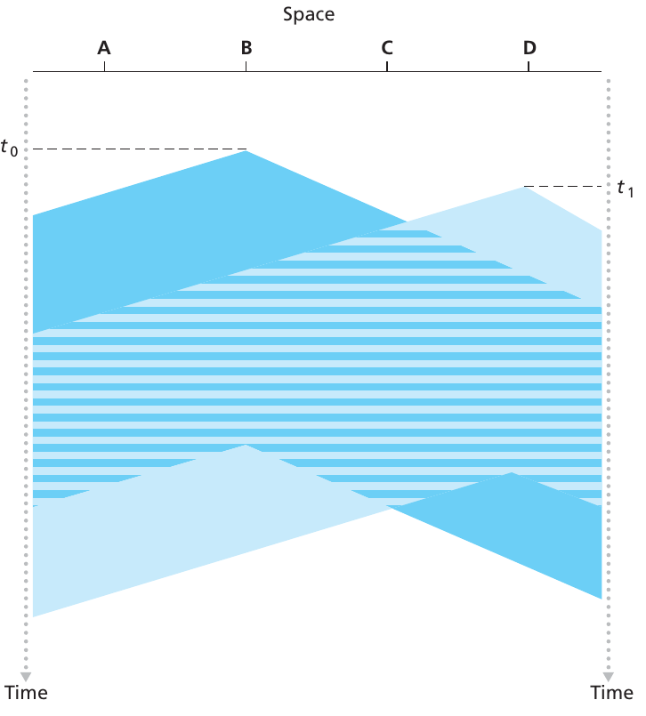
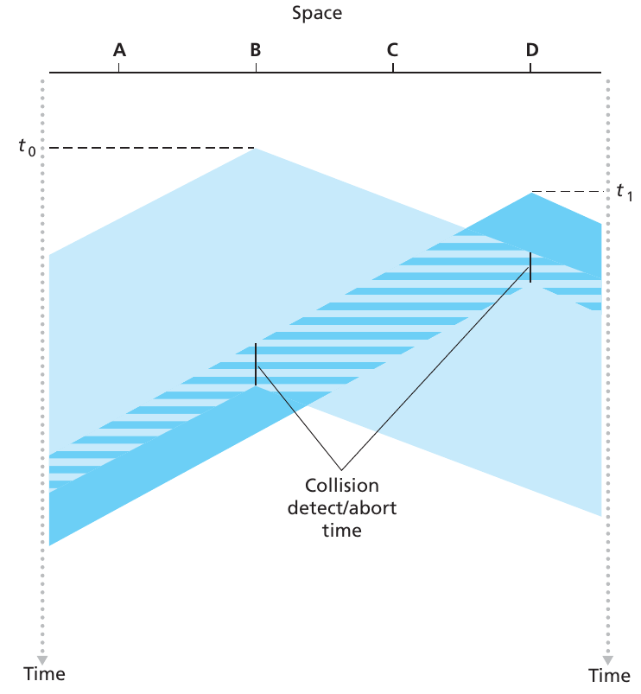
CSMA/CD: Collision Detection

Slide 21
CSMA/CD: Collision Detection
When a collision occurs, the computers interrupt the transmission and wait for some (random) time
Collision detection during transmission is easy to implement in wired networks: "nodes listen to what they transmit"
In wireless networks, turning on the receiver while the transmitter is operating would cause the receiver to break. Solutuion: use CSMA/CA

Slide 22
MACA - Collision Avoidance
MACA (Multiple Access with Collision Avoidance) uses short signal packets to prevent collisions
RTS (request to send): the sender asks for permission before transmitting the message.
CTS (clear to send): the recipient issues a permission
Signal packets contain
sender's address
recipient's address
data size

Slide 23
DAMA - Demand Assigned Multiple Access
Efficiency of channel usage: 18% for Aloha, 36% for Slotted Aloha
Channel redundancy can increase efficiency by up to 80%
sender reserves timeslot in the future to send data
sending data in a reserved timeslot is guaranteed to occur without collisions
reserving results in longer response times
Examples of algorithms:
Reservation-ALOHA
Implicit reservation
Reservation in TDMA

Slide 24
DAMA: Reservation-ALOHA
Two modes:
reservation requests (ALOHA): nodes send requests for reservations, collisions are possible
sending data in a reserved time slot (no collisions)
collisions
t
requests
requests
requests
requests
data
data
data

Slide 25
DAMA: Implicit Reservation
PRMA – multiple access with packet reservation
a fixed set of time slots forms a frame; frames are repeated
nodes compete for empty slots as in slotted ALOHA
if a node has reserved a slot, then it will belong to it for all frames while the node is sending data
if the node did not use the slot, then in the next frame it will be considered as a not reserved slot

Slide 26
DAMA: Reservation in TDMA
Each frame consists of N mini slots (by the number of nodes) and x data slots (x changes from frame to frame)
Each node has its own mini-slot it can also be used to signal the need to send data.
The time to send data in the next frame is divided equally between the nodes that have sent the signal

Slide 27
Serial Access Protocols
Problem with secure channel separation (TDM and FDM): a single node cannot use the entire channel when it is free
Random access protocols allow you to do this, but different nodes "interfere" with each other
Serial access protocols allow you to safely split or fully utilize a channel if it is not occupied
Polling protocol: the master node of the network allows nodes to transmit data in turn. Problems: additional costs for sending permissions; main node failure
Token Transfer Protocol: a token (special frame) is passed from one node to another. Problem: we need special algorithms for the case of token loss.

Slide 28
Addressing in local networks
MAC–address (6 bytes) 00:1e:4a:82:ec:00
ARP Protocol convert addresses to MAC addresses
Matching table with IP and MAC-addresses is stored on each computer
To find out MAC-address a host executes the broadcast request: "Does anyone know the physical address of the device that has the following IP address?"

Slide 29
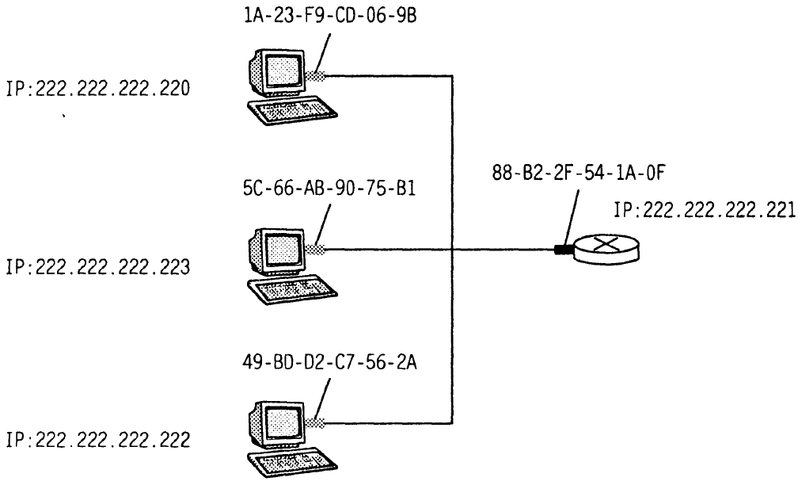
Addressing in local networks

Slide 30
ARP-tables Example
mmcs-d1.r61.net (195.208.237.1) at 00:1e:4a:82:ec:00
r203-04.mmcs.rsu.ru (195.208.237.67) at 00:14:85:83:10:33
r202-04.mmcs.rsu.ru (195.208.237.103) at 00:18:f3:10:fe:6b
edu.mmcs.rsu.ru (195.208.237.128) at 00:1c:23:d4:aa:37
class.mmcs.rsu.ru (195.208.237.129) at 00:1c:23:d4:aa:37
web.mmcs.rsu.ru (195.208.237.241) at 00:1c:23:d4:aa:37
? (192.168.10.3) at 00:16:76:a2:92:e3
? (192.168.10.52) at 00:1e:4f:97:5c:8f
? (192.168.11.101) at 00:19:5b:ef:18:88
? (192.168.11.102) at 00:19:5b:ee:c2:d0
? (192.168.11.118) at 00:19:5b:7e:2e:41
? (192.168.11.119) at 00:19:5b:ef:18:8d

