Slide 1
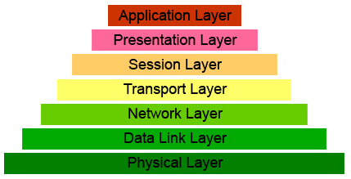
Transport layer

Slide 2
Transport layer functions
provides a logical connection between applications
implements reliable data transmission
provides data transfer rate control
Protocols: TCP (reliable) and UDP (unreliable)

Slide 3
Programming features
Streaming connection TCP
situation a):
computer1 uses the function send once
computer2 doesn’t receive whole information in one call recv (need multiple calls)
situation b):
computer1 uses the function send several times
computer2 receives whole information for one recv call

Slide 4
Programming features
Datagram protocol UDP
situation a) - impossible
computer1 uses the function sendto once, at the network level UDP segment is splited into several IP packets
computer2 always receives the segment in one call recvfrom and only, if no IP packets were lost
situation b) - impossible
different sendto calls on computer1 correspond to different UDP datagrams and different calls of recvfrom on computer2

Slide 5
Programming features
If the buffer in functions recv and recvfrom is less than the size of the sent data, then in case UDP some of the data is lost, and in the case of TCP - the remaining data is saved for a later recv call.
UDP server has one socket, but TCP server has many different sockets (each corresponds to a simultaneously connected client). Each TCP socket receives information from corresponding client

Slide 6
Multiplexing and demultiplexing
Multiplexing - collecting messages from sockets of all applications, adding headers and transmitting packets through one channel
Demultiplexing – distribution of incoming data across sockets
for UDP the desired socket is determined by the recipient's port number
for TCP – recipient's port number, IP-sender's address and port number

Slide 7
Protocol UDP
UDP (User Datagram Protocol) – performs a minimum of actions, allowing the application to work almost directly with the network layer
Much faster TCP
no need to establish a connection
Possible segment losses
Checks the correctness of transmitted data (checksum)

Slide 8
Structure of the
UDP segment
The header is only 8 bytes long

Slide 9
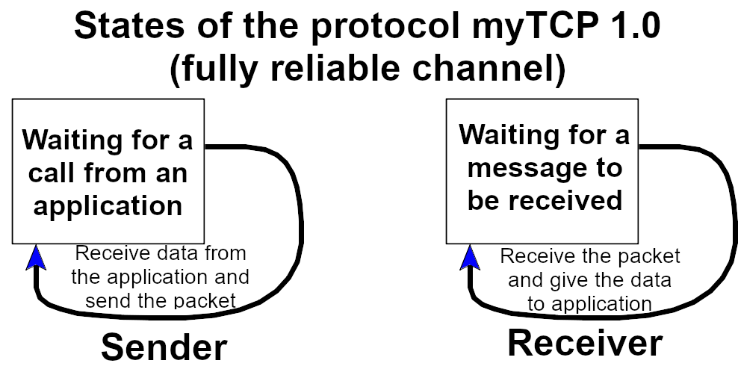
Principles of reliable data transmission

Slide 10
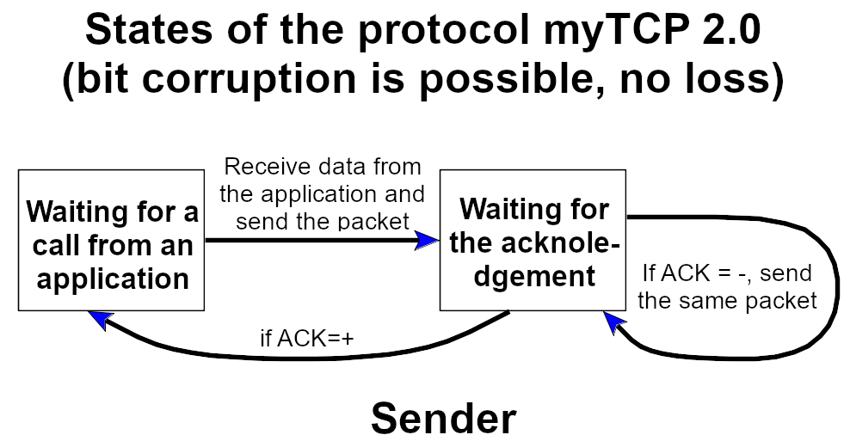
myTCP2.0 - sender

Slide 11
myTCP2.0 - receiver

Slide 12
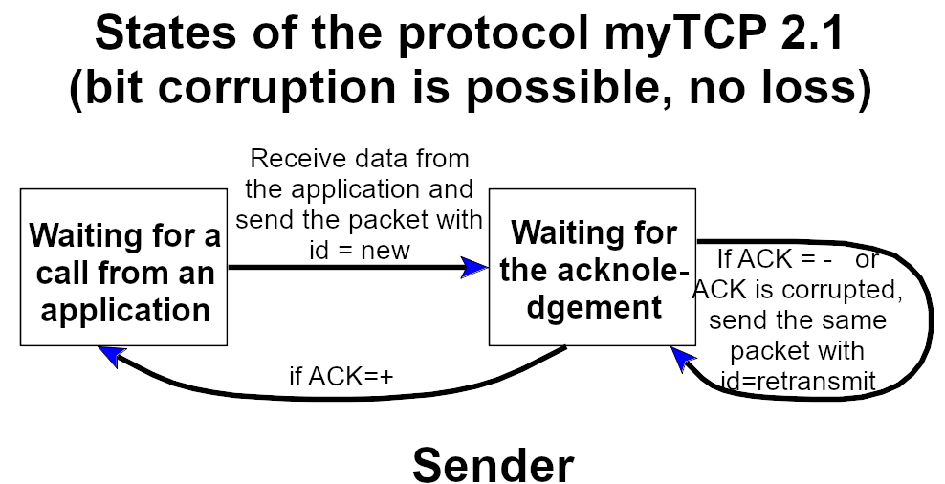
myTCP 2.1 - acknowledgements can also be corrupted!

Slide 13
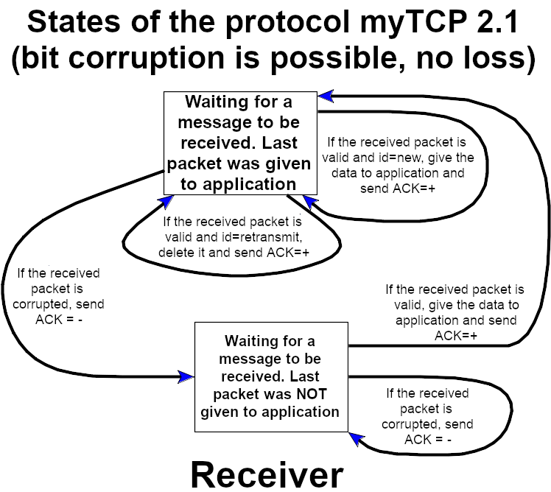

Slide 14
Mistake
Find the error in the protocol myTCP 2.1

Slide 15
MyTCP 3.0 - Loss is Possible
You need to be able to detect the fact of packet loss, for example, to wait for some time after the packet is sent
You need to number the packets
In acknowledgments, you must specify the number of the packet to which it corresponds
Homework: think on the sender and receiver schemes in this case

Slide 16
Drawback
of stop and wait protocols
There is a 1GB channel Rostov-Moscow
Time to send 1000 bytes = 8000 bits: 8000 bits / 1 Gb / s = 8 microseconds
Signal propagation time:
1000 km / 300,000 km/s = 3333 microseconds
Therefore: the next 1000 bytes will be sent in more than 6674 microseconds
Conclusion: 99.9% of the time the channel is not used

Slide 17
Pipelining.
Sliding window protocols
Solution: send packets in groups without waiting for acknowledgements - this is pipelining
Two approaches:
GBN - Go Back N
SR- Selective Repeat

Slide 18
Format TCP-of the segment
Notes:
NS (1 bit): ECN-nonce - concealment protection
CWR (1 bit): Congestion window reduced (CWR) flag is set by the sending host to indicate that it received a TCP segment with the ECE flag set and had responded in congestion control mechanism
ECE (1 bit): ECN-Echo has a dual role, depending on the value of the SYN flag. It indicates:
If the SYN flag is set (1), that the TCP peer is ECN capable.
If the SYN flag is clear (0), that a packet with Congestion Experienced flag set (ECN=11) in the IP header was received during normal transmission.[b] This serves as an indication of network congestion (or impending congestion) to the TCP sender.
URG (1 bit): Indicates that the Urgent pointer field is significant
ACK (1 bit): Indicates that the Acknowledgment field is significant. All packets after the initial SYN packet sent by the client should have this flag set.
PSH (1 bit): Push function. Asks to push the buffered data to the receiving application.
RST (1 bit): Reset the connection
SYN (1 bit): Synchronize sequence numbers. Only the first packet sent from each end should have this flag set. Some other flags and fields change meaning based on this flag, and some are only valid when it is set, and others when it is clear.
FIN (1 bit): Last packet from sender

Slide 19
Sequence and Acknowledgement Numbers
Sequence number of the segment — number of the first byte of this segment
Acknowledgement number is the sequence number of the next waiting byte

Slide 20
Protocol TCP Triple Handshake

Slide 21
Congestion Control in TCP

Slide 22
Congestion Control in TCP

Slide 23
Homework
Create a testing program for TCP-connections. It should simply transfer random data from one computer to another and calculate the speed of the TCP connection. Measure the quality of the TCP driver implementation: the speed of the TCP connection
for Linux (for 100 MB / 1 GB connections)
for Windows (for 100 MB / 1 GB connections)

