Slide 1
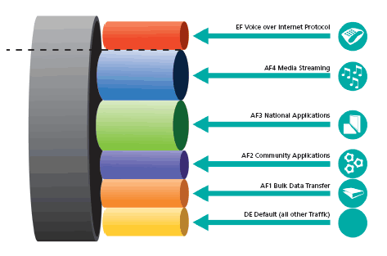
Quality of service
QoS

Slide 2
Types of applications
Elastic
Support a wide range of bandwidth values, although, of course, the higher the better
Example: FTP, torrent, HTTP, email
Streaming apps
the bandwidth may vary within acceptable limits
they can adapt to moderate bandwidth / high packet loss / high ping time, for example, by changing the quality of the transmitted video signal or increasing the buffer
Real-time applications
Can't adapt to small bandwidth / high packet loss / high ping time
Example: IP-telephony, online multiplayer games, and real-time management applications

Slide 3
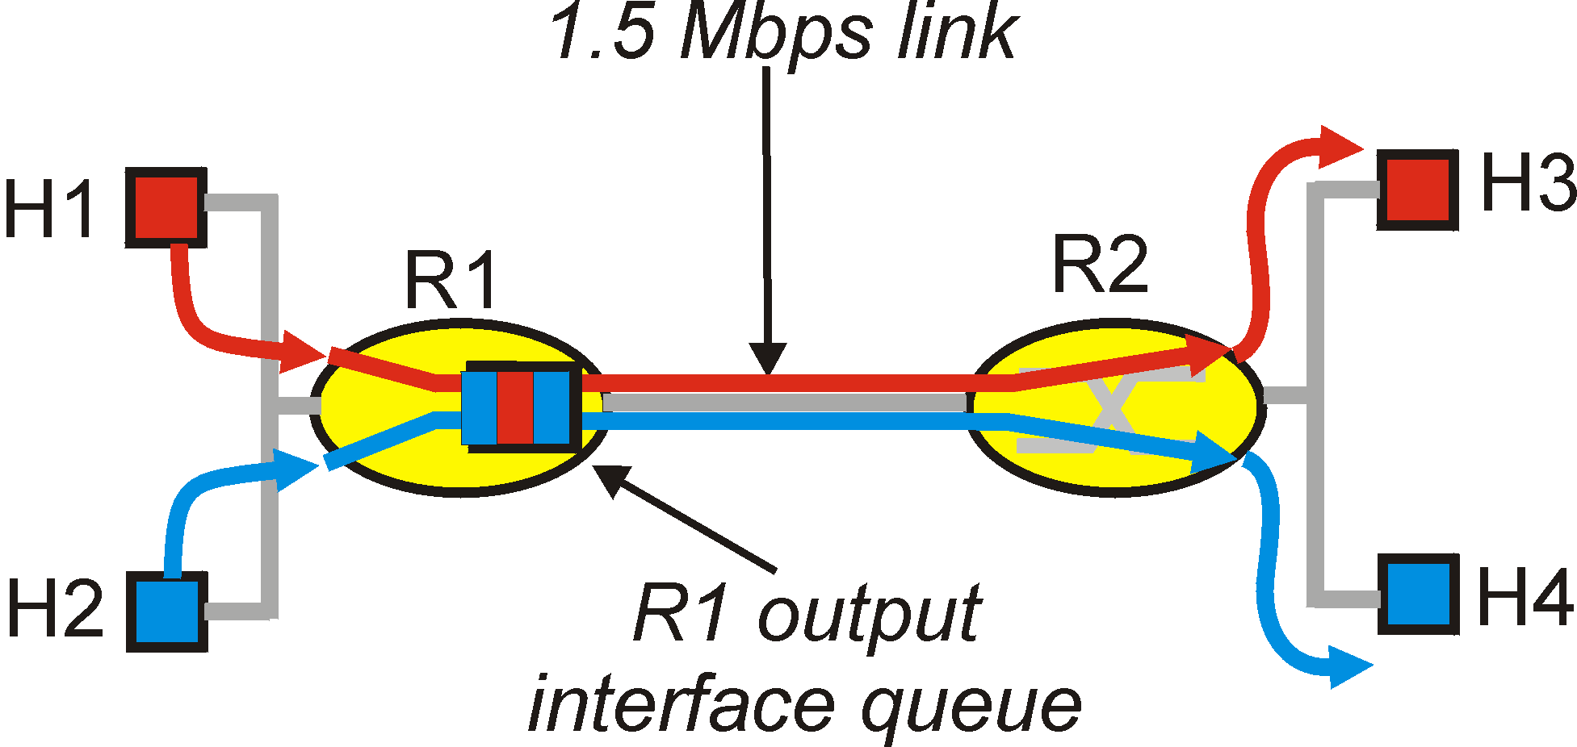
Quality of Service (QoS)
Data transfer takes place on the principle of "best effort"- as soon as possible according to the available capabilities
IETF works on standards that provide quality assurance for network connections
IntServ, RSVP
DiffServ
Model for congestion analysis when multiple hosts share the same connection

Slide 4
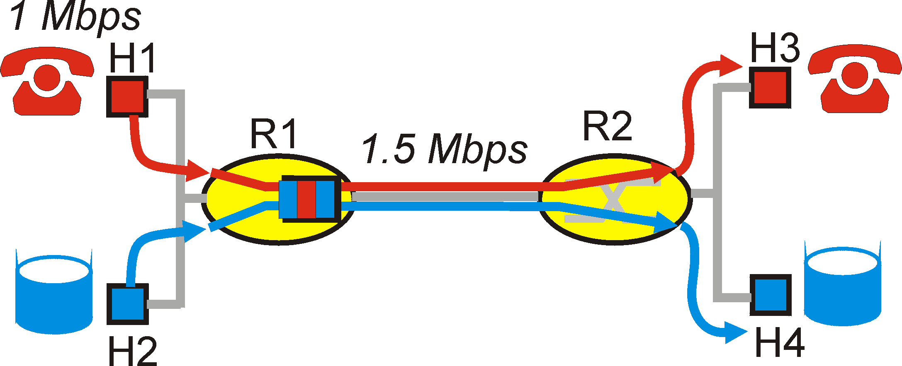
QoS Principles
Consider the VoIP app (1Mbps) and uTorrent use the common channel 1.5 Mbps
downloading the file may cause the router to discard audio data
we would like to provide VoIP priority over uTorrent
Principle 1: We need to define the packet classes, make routers to distinguish them and process correctly

Slide 5
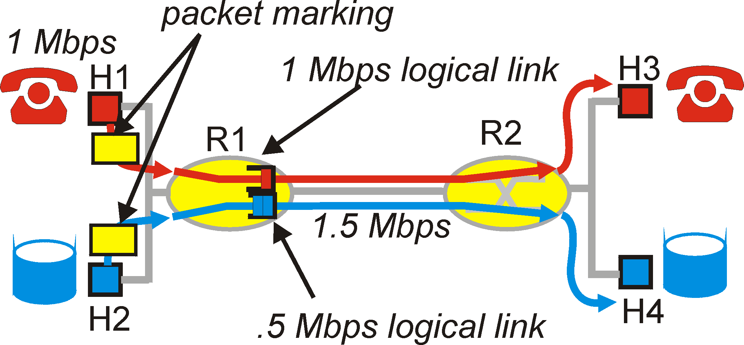
QoS Principles
High priority VoIP app may try to take over the entire channel
Principle 2: Classes should not oust each other, reducing the throughput of other classes below the specified one
A simple solution - to reserve a permanent part of the channel for each type of traffic - is inefficient

Slide 6
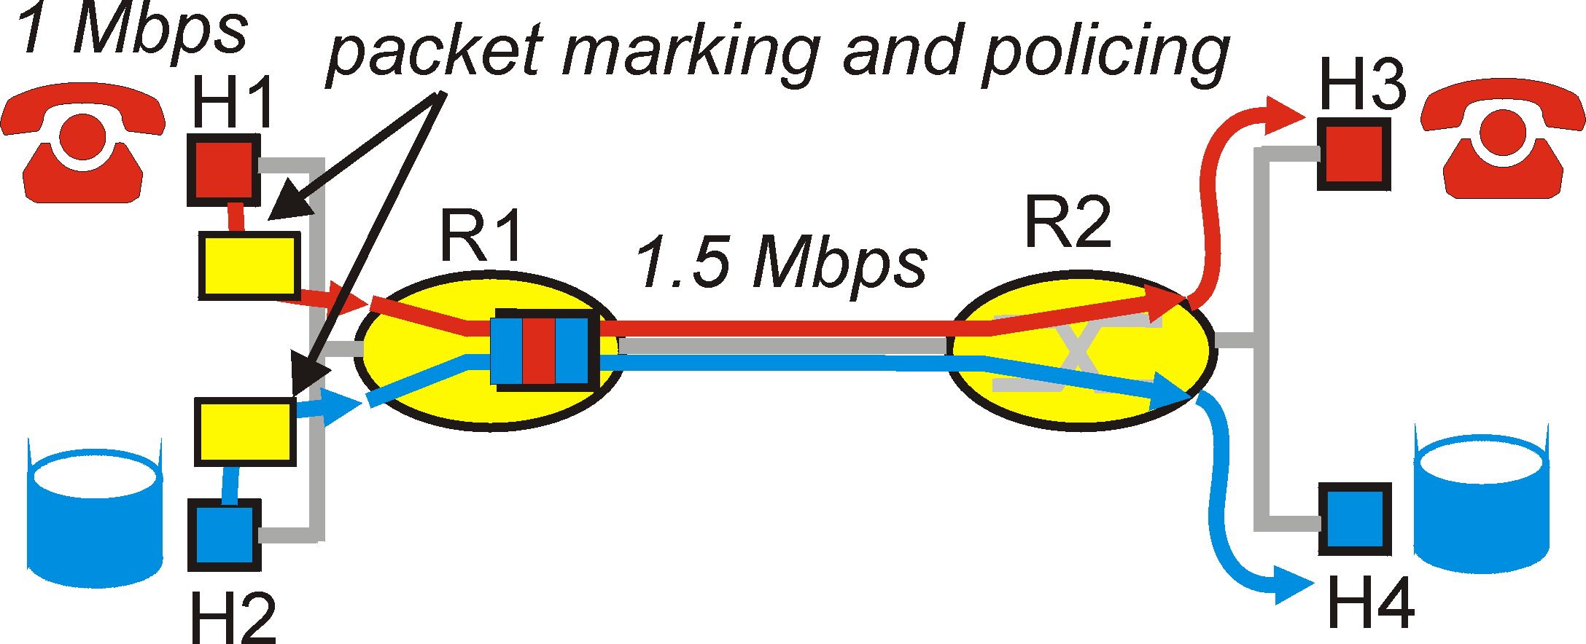
QoS Principles
Principle 3: By isolating the traffic classes, we need to ensure that the channel is used efficiently
Possible solution: Weighted fair queuing, WFQ

Slide 7
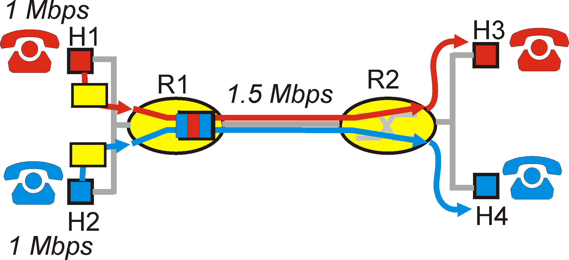
QoS Principles
Problem: given all the priorities, the bandwidth may not be sufficient for this type of traffic
Principle 4: Tools are needed to check the availability of the necessary resources. The application asks the network if the necessary resources are available

Slide 8
Total
Marking network packets
Class isolation
Channel utilization
Checking the available resources
Quality of Service

Slide 9
History of the QoS
Research in the 80s and early 90s was based on circuit switching
QoS in ATM networks and IntServ technology were developed Features:
strict quality control of the connection from end to end
standards meeted the needs of streaming and real-time applications
In recent years, another scalable technology has gained popularity: Differentiated services
DiffServ based on processing aggregated traffic classes rather than individual streams

Slide 10
Integrated Services
The application must first request network resources and report the parameters of the transmitted traffic:
R-spec define the service class: 'best effort‘, load-controlled service or guaranteed service
T-spec define the algorithm parameters of the current bucket for traffic (recoil rate R and the queue size B).

Slide 11
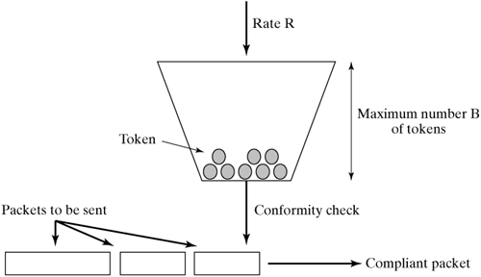
Token bucket

Slide 12
Protocol RSVP
RSVP – network resource reservation protocol (Resource ReSerVation Protocol) serves for transmitting R-spec and T-spec through the router chain
before transmitting data, the source node sends messages over the network that reserve a certain bandwidth and class of service
routers are configured so that the specified stream is always provided with the required bandwidth.

Slide 13
Differentiated Services (DiffServ)
Designed to overcome the following disadvantages IntServ and RSVP:
Scalability: in large networks, the number of threads is measured in the tens of thousands; routers can't cope
Limited number of service classes: Intserv supports only 3 classes; intermediate types are often required
Complex resource reservation system: many applications and users only need to specify that certain traffic should have a higher priority on the provider's router

Slide 14
Differentiated Services (DiffServ)
Very few applications really need strict and precise quality of service guarantees
DiffServ based on free classification of traffic divided into a small number of "priority" classes
Unlike RSVP, in the case of DiffServ, the sender and receiver do not exchange information about quality of service requirements

Slide 15
Architecture DiffServ
Service Level Agreement (SLA) – traffic classification + rules for external traffic relabeling + actions with traffic flows for the domain (provider's routers set)
Edge routers perform traffic labeling
Internal routers process packets according to the markers assigned to them (Per-Hop Behavior, PHB)

Slide 16
Packet markering
DSCP – DiffServ Code Point
The marker is placed in the IP header field “Type of Service” in IPv4
6 bit, 2-reserved. Total of 16 classes

Slide 17
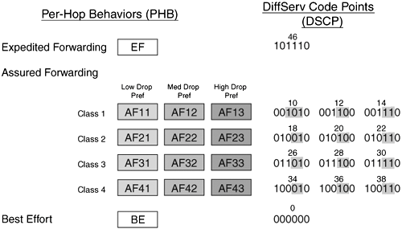
Package labeling

Slide 18
Comparison
Best-Effort
Diffserv
Intserv
Aggregated isolation of stream classes
Guarantees for stream classes
Features
linking two nodes
no stream isolation
no guarantees
Thread isolation
Guarantees for for each thread
Locality
works for all nodes in the chain
works in the provider domain
works for all nodes in the chain
settings for stream classes
settings for each stream separately
Complexity
no settings available
High scalability (nodes only work with route information)
Scaling up (border nodes store information about labeling, internal nodes store information about class priorities)
Don't scale (each router stores information about each stream)
Scalability

Slide 19
Homework
Find out on the Internet what classes are usually assigned to different types of traffic
Find a match between common classes of Cisco and AF (DSCP)
Managing channel width in Linux: https://habrahabr.ru/post/133076/

Slide 20
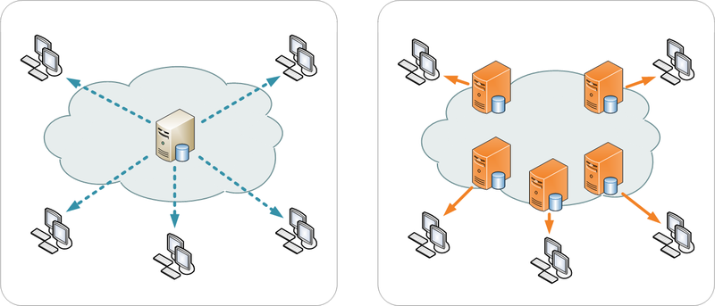
Content delivery networks
Content Delivery Networks

Slide 21
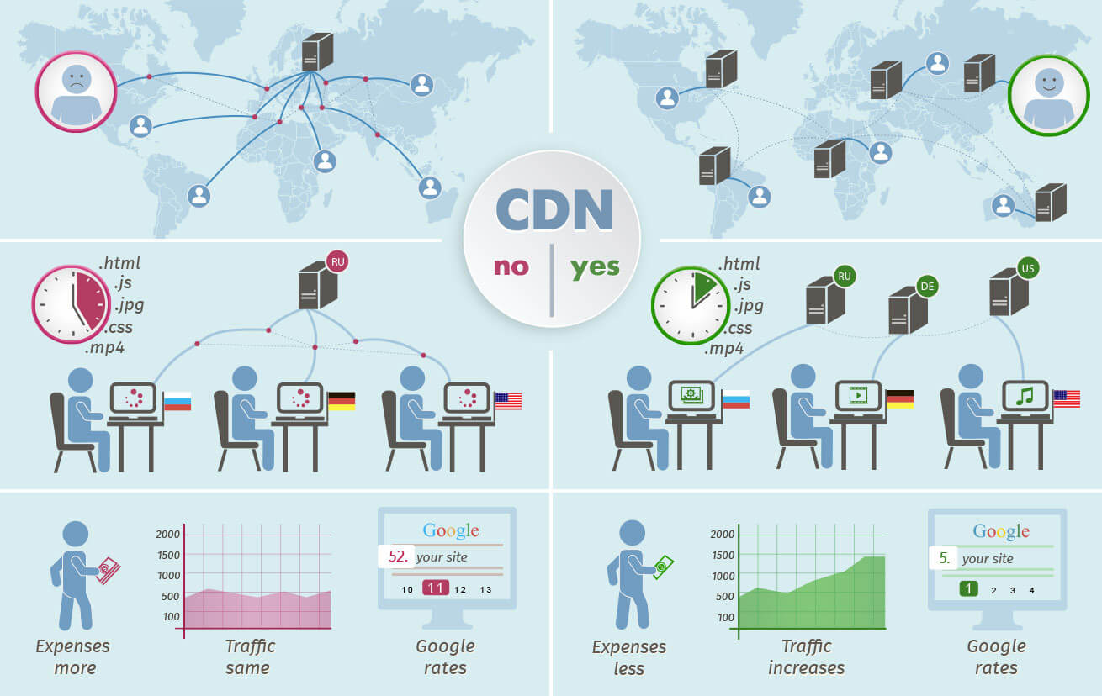
Content delivery networks

Slide 22
Classification of CDN
By network structure:
single-provider network
overlay network
By type of transmitted information:
static files, images, and texts
multimedia: audio and video streams
dynamically generated HTML

Slide 23
Tasks
Distributed data storage (close to clients)
Routing to the nearest server
Data delivery
Calculating statistics (for invoicing)

Slide 24
Distributed data storage
Static images, texts, and javascript libraries:
download from the main server and cache it
when you change it, sync across all servers on the network
Multimedia: distributed across servers in advance
Dynamically generated pages they need to be pre-configured

Slide 25
Routing and delivery
IP-anycast, IP-multicast
DNS-selection
Map-based
Racing-based
HTTP redirection

